Slide 1
Additional Resources

Slide 2
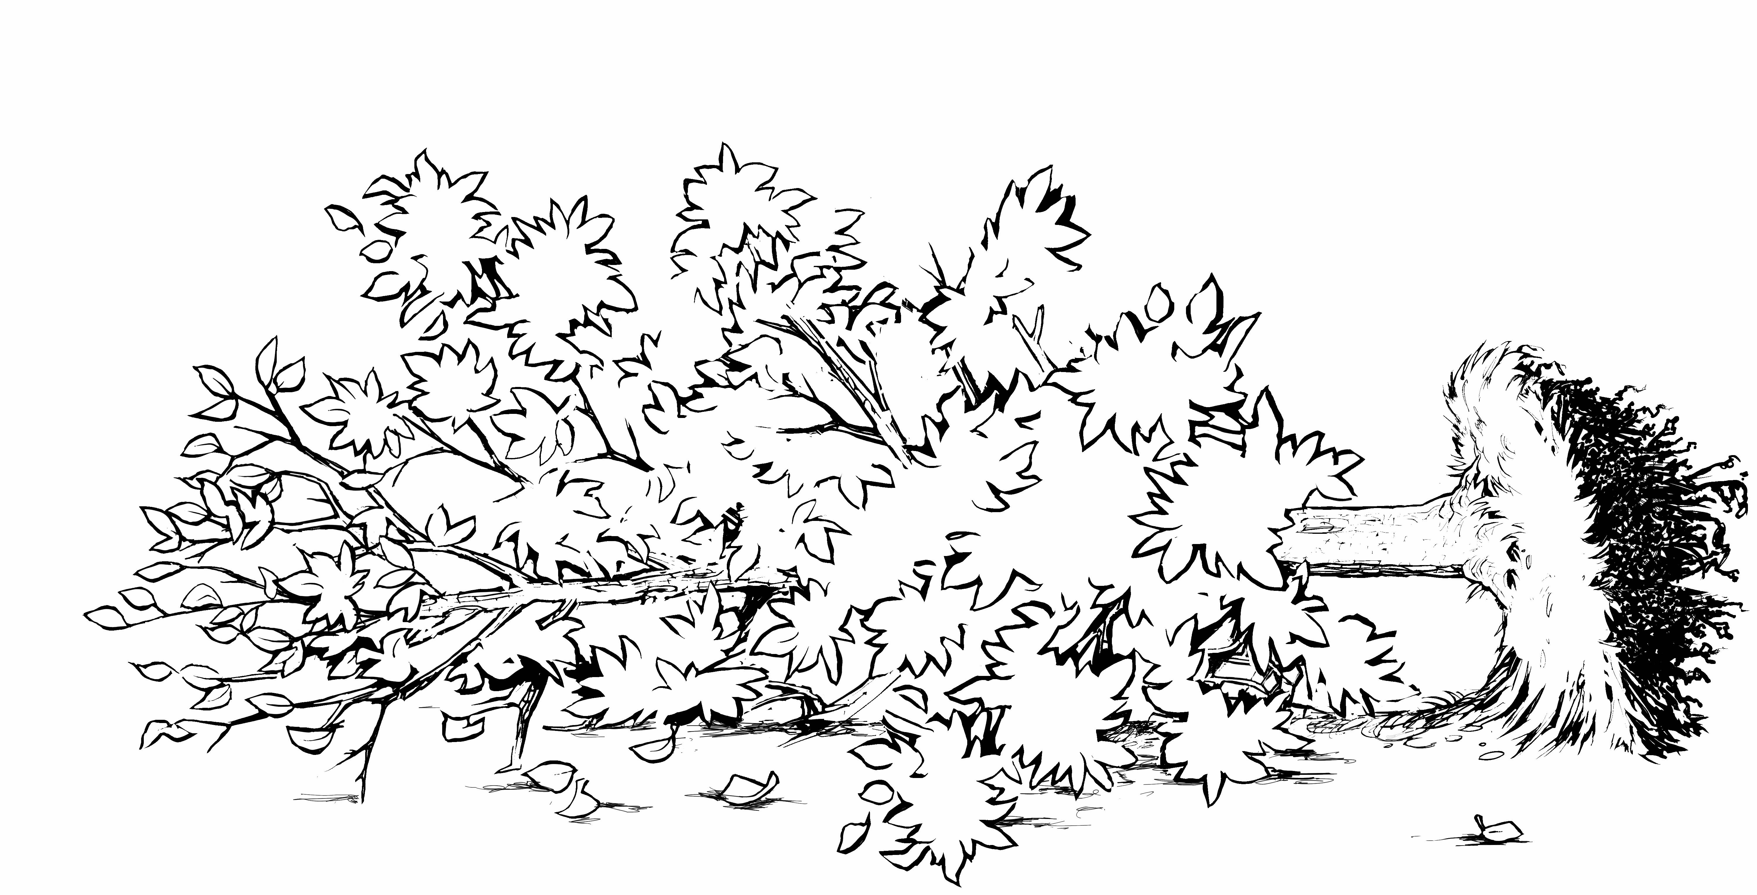
Notes:
#75 This is a non-written evaluation.
Ask the class what they would do to remove this storm damaged tree.
Discussion points they should bring up.
First: Put on PPE
Next: Check the Saw
Identify the hazards and establish the work and drop zone.
Lean and load is tricky because we can’t see what is going on so we should take off the foliage.

Slide 3
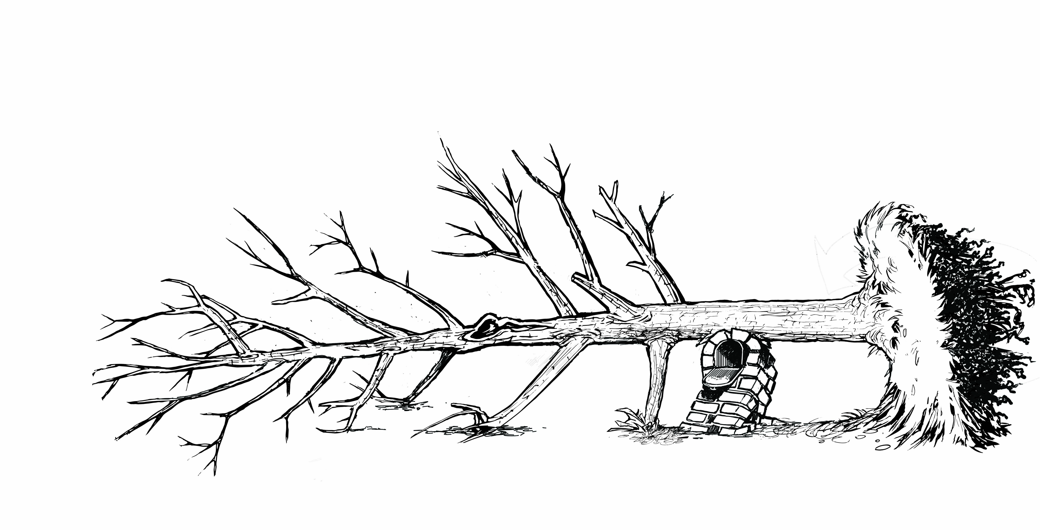
Notes:
#76. Evaluation continued
Make sure they note the new hazards (mailbox and cavity)
Have a discussion on lean and load, tension and compression wood.
Develop a cut plan and escape plan.

Slide 4
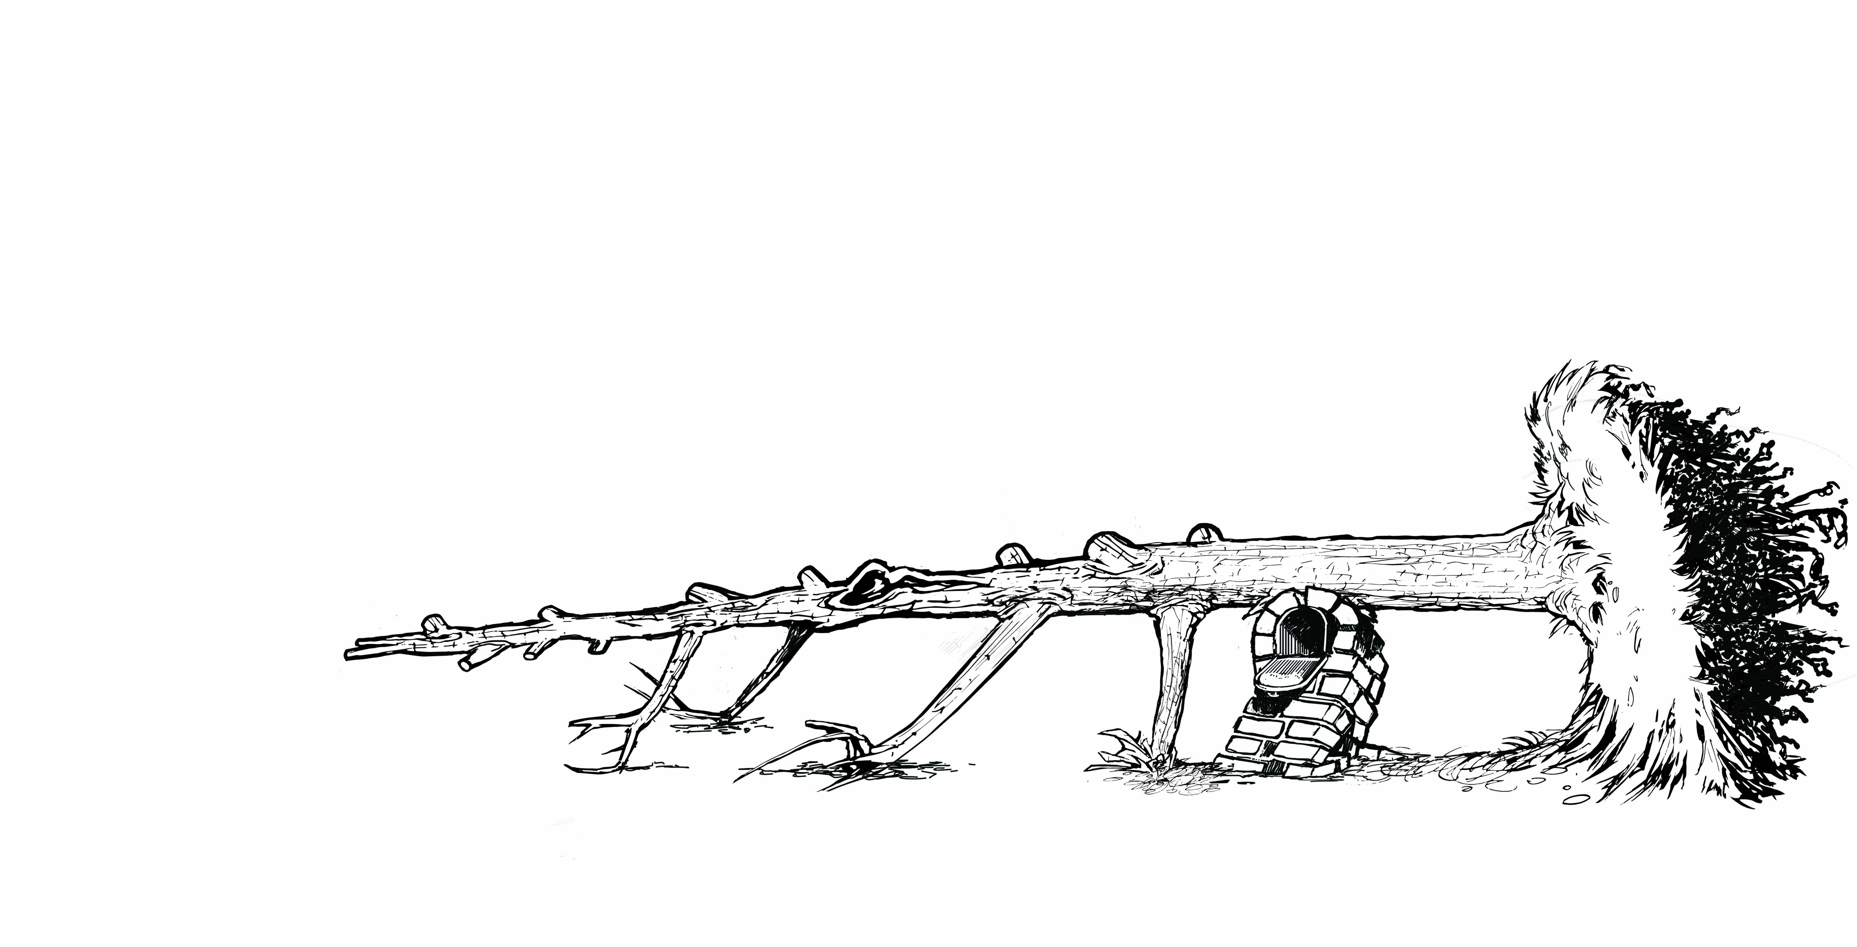
Notes:
#74 Evaluation Continued
Encourage conversation. These are points that could be discussed:
Work from the end toward the root mass.
Discuss escape routes
Will the tree stand up? Or the trunk fall down?
Can you save the mailbox? Do you care?
Talk about tension/compression in wood around the mail box.

Slide 5
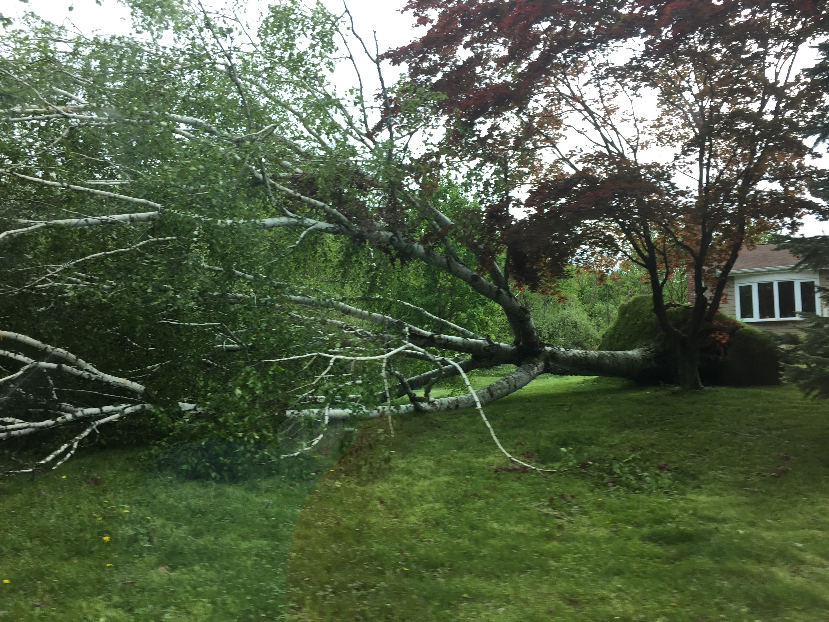
Notes:
Criana https://www.flickr.com/photos/criana/42194458961/

Slide 6
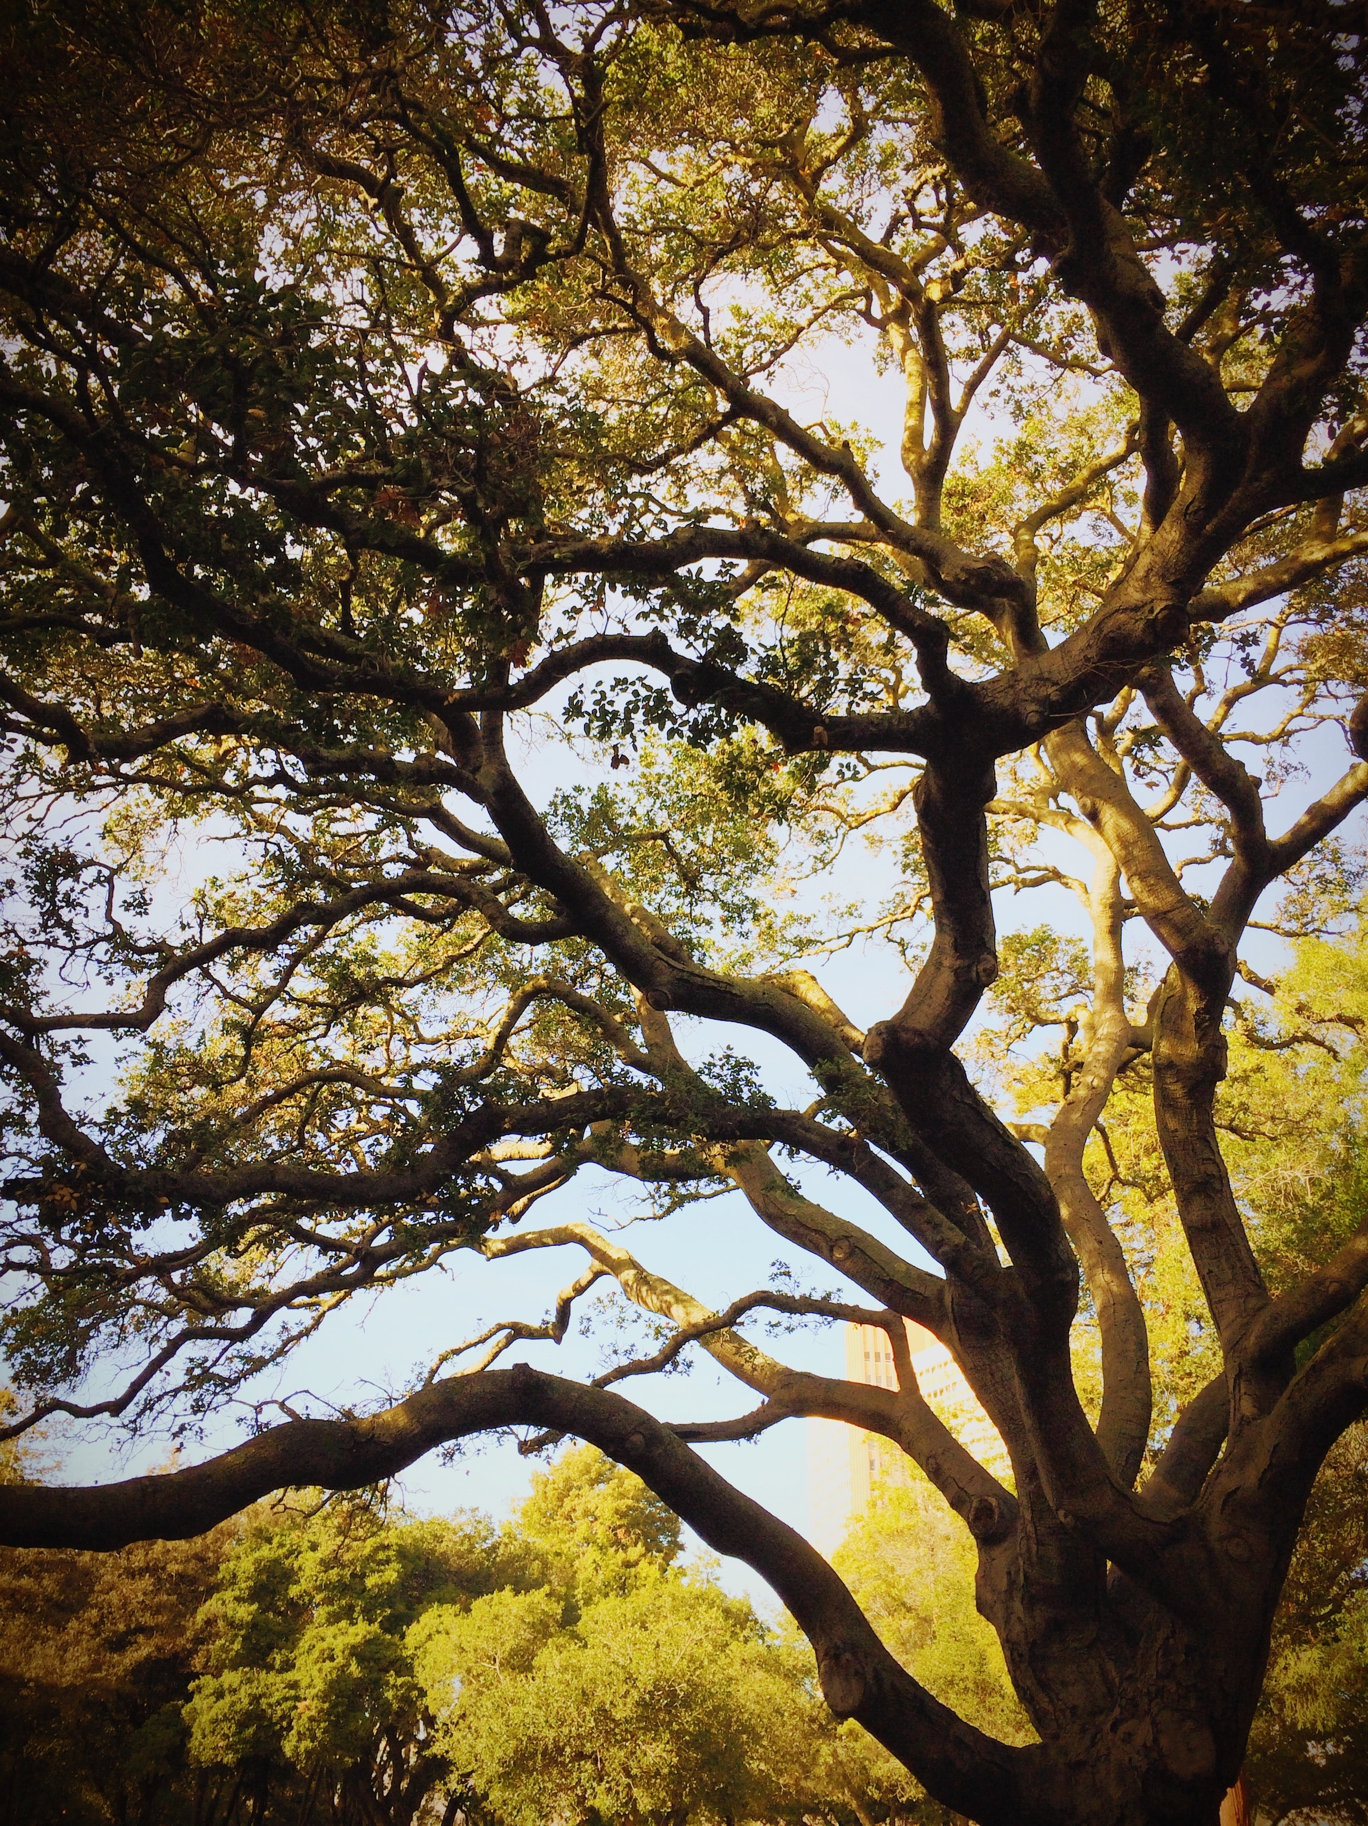
Notes:
Photo by Victor Zambrano on Unsplash

Slide 7
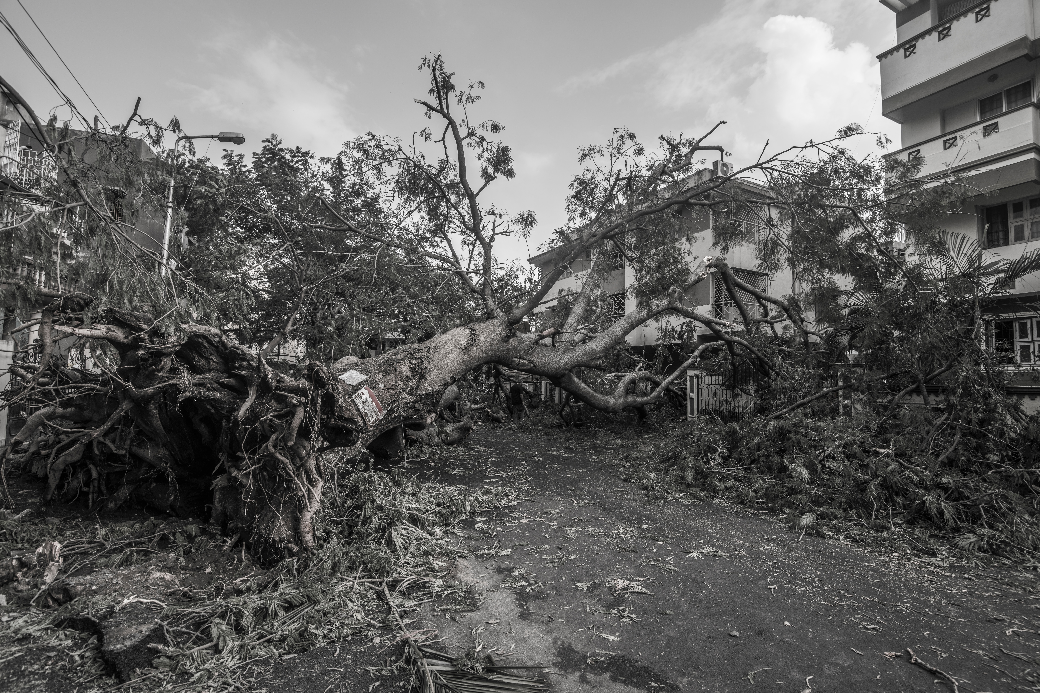
Notes:
Photo by Karthik Chandran on Unsplash

Slide 8
Notes:
Photo by Zach Reiner on Unsplash

Slide 9
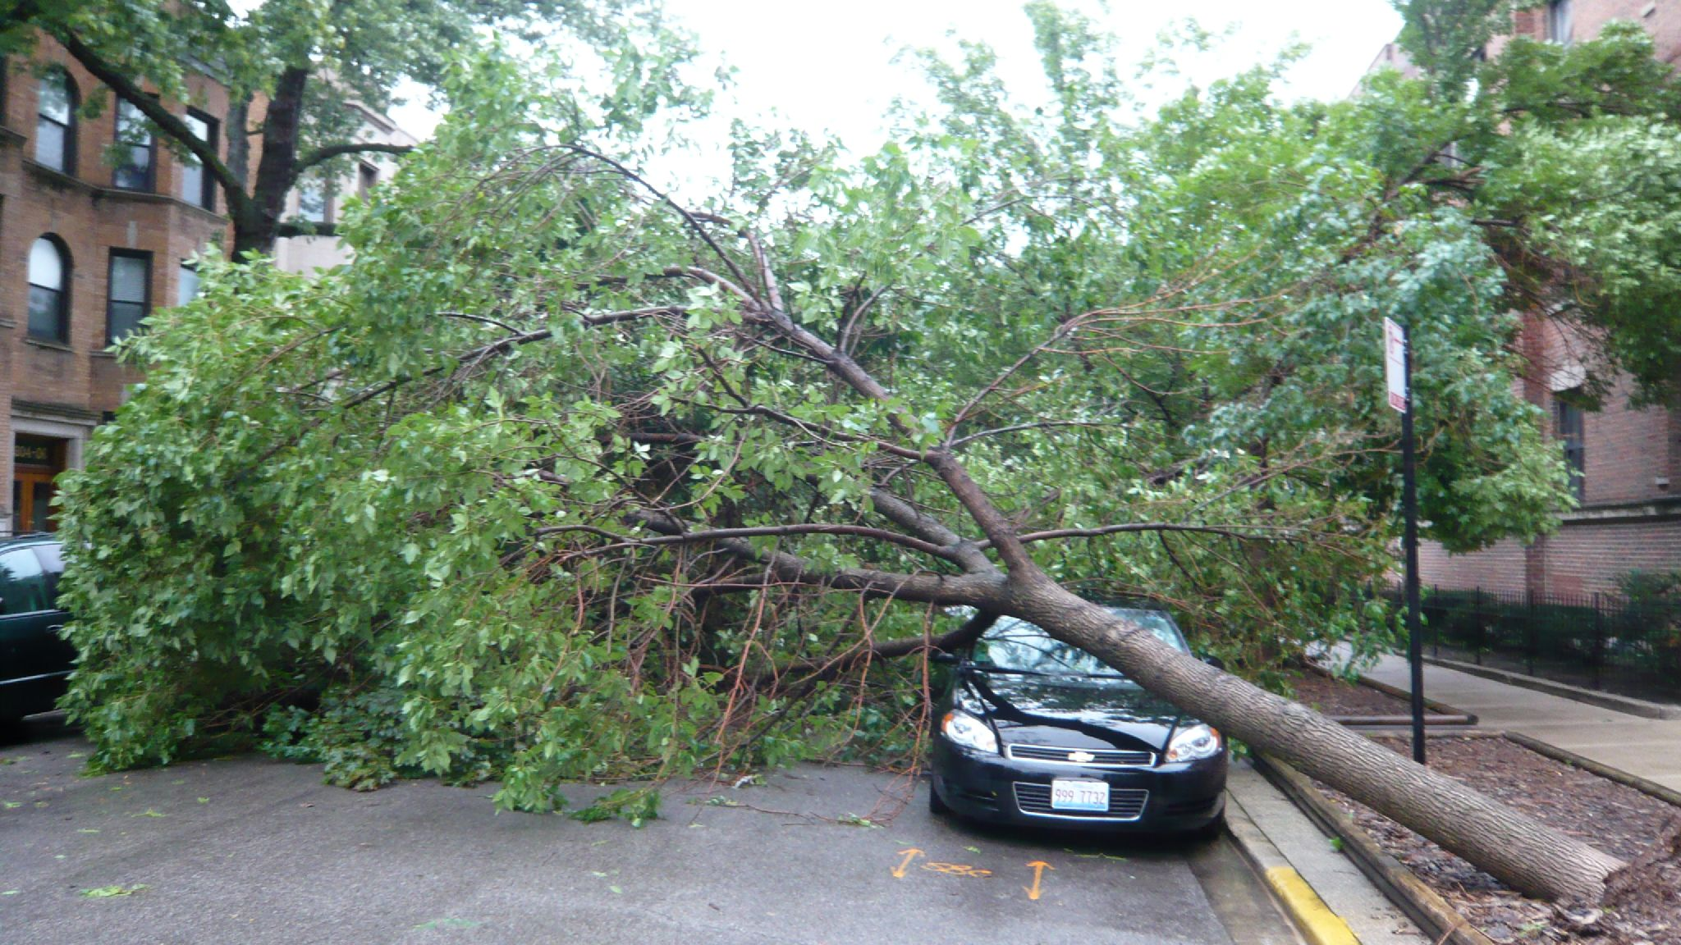
Notes:
Jeremy_h
https://www.flickr.com/photos/jeremyhollis/

Slide 10
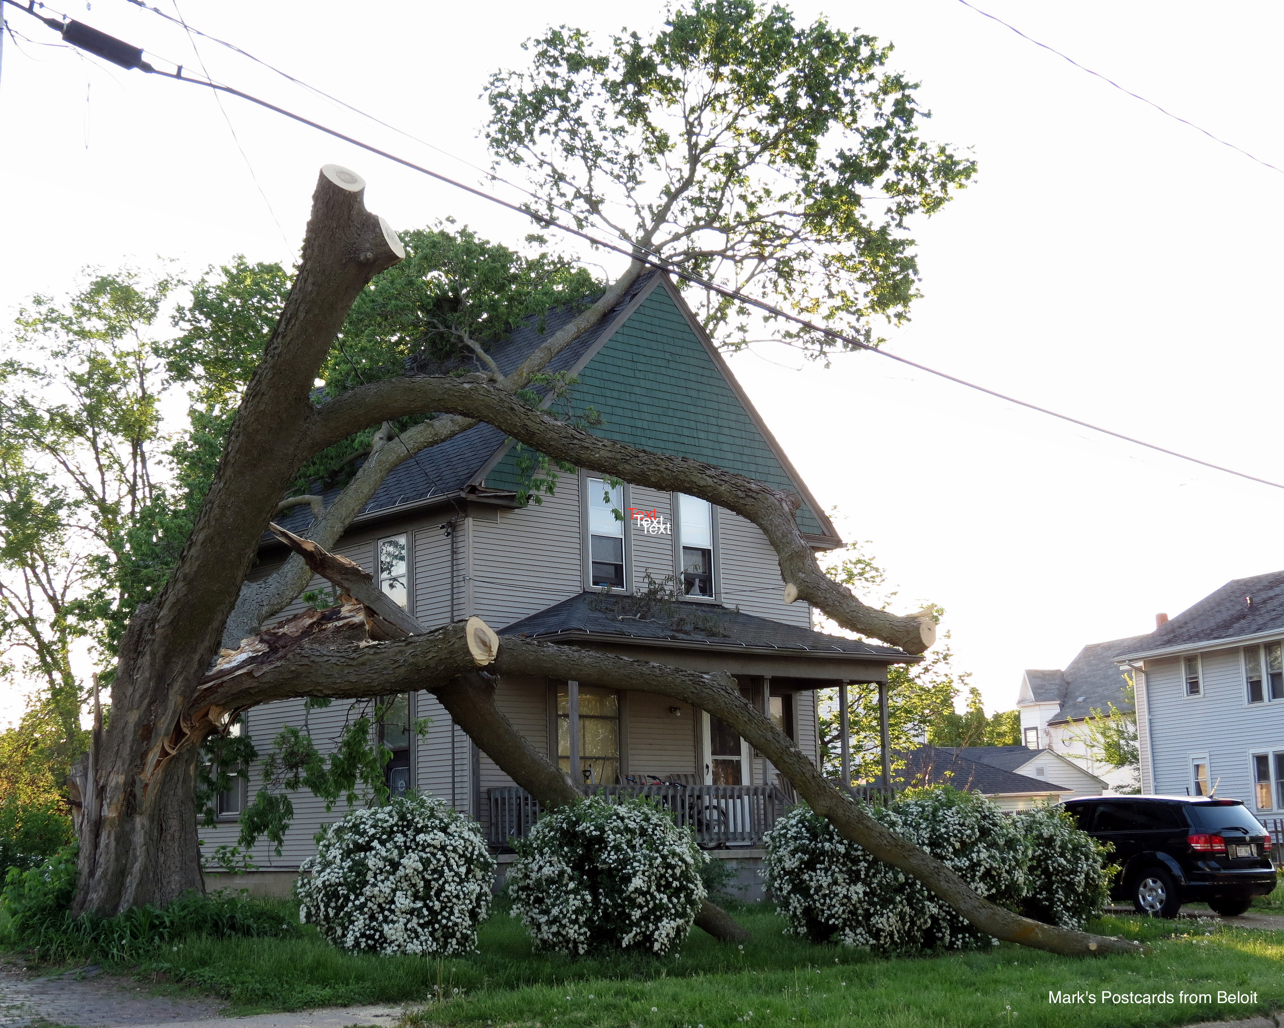
Notes:
Mark
S Postcards from Beloit
https://www.flickr.com/people/oldonliner/

Slide 11
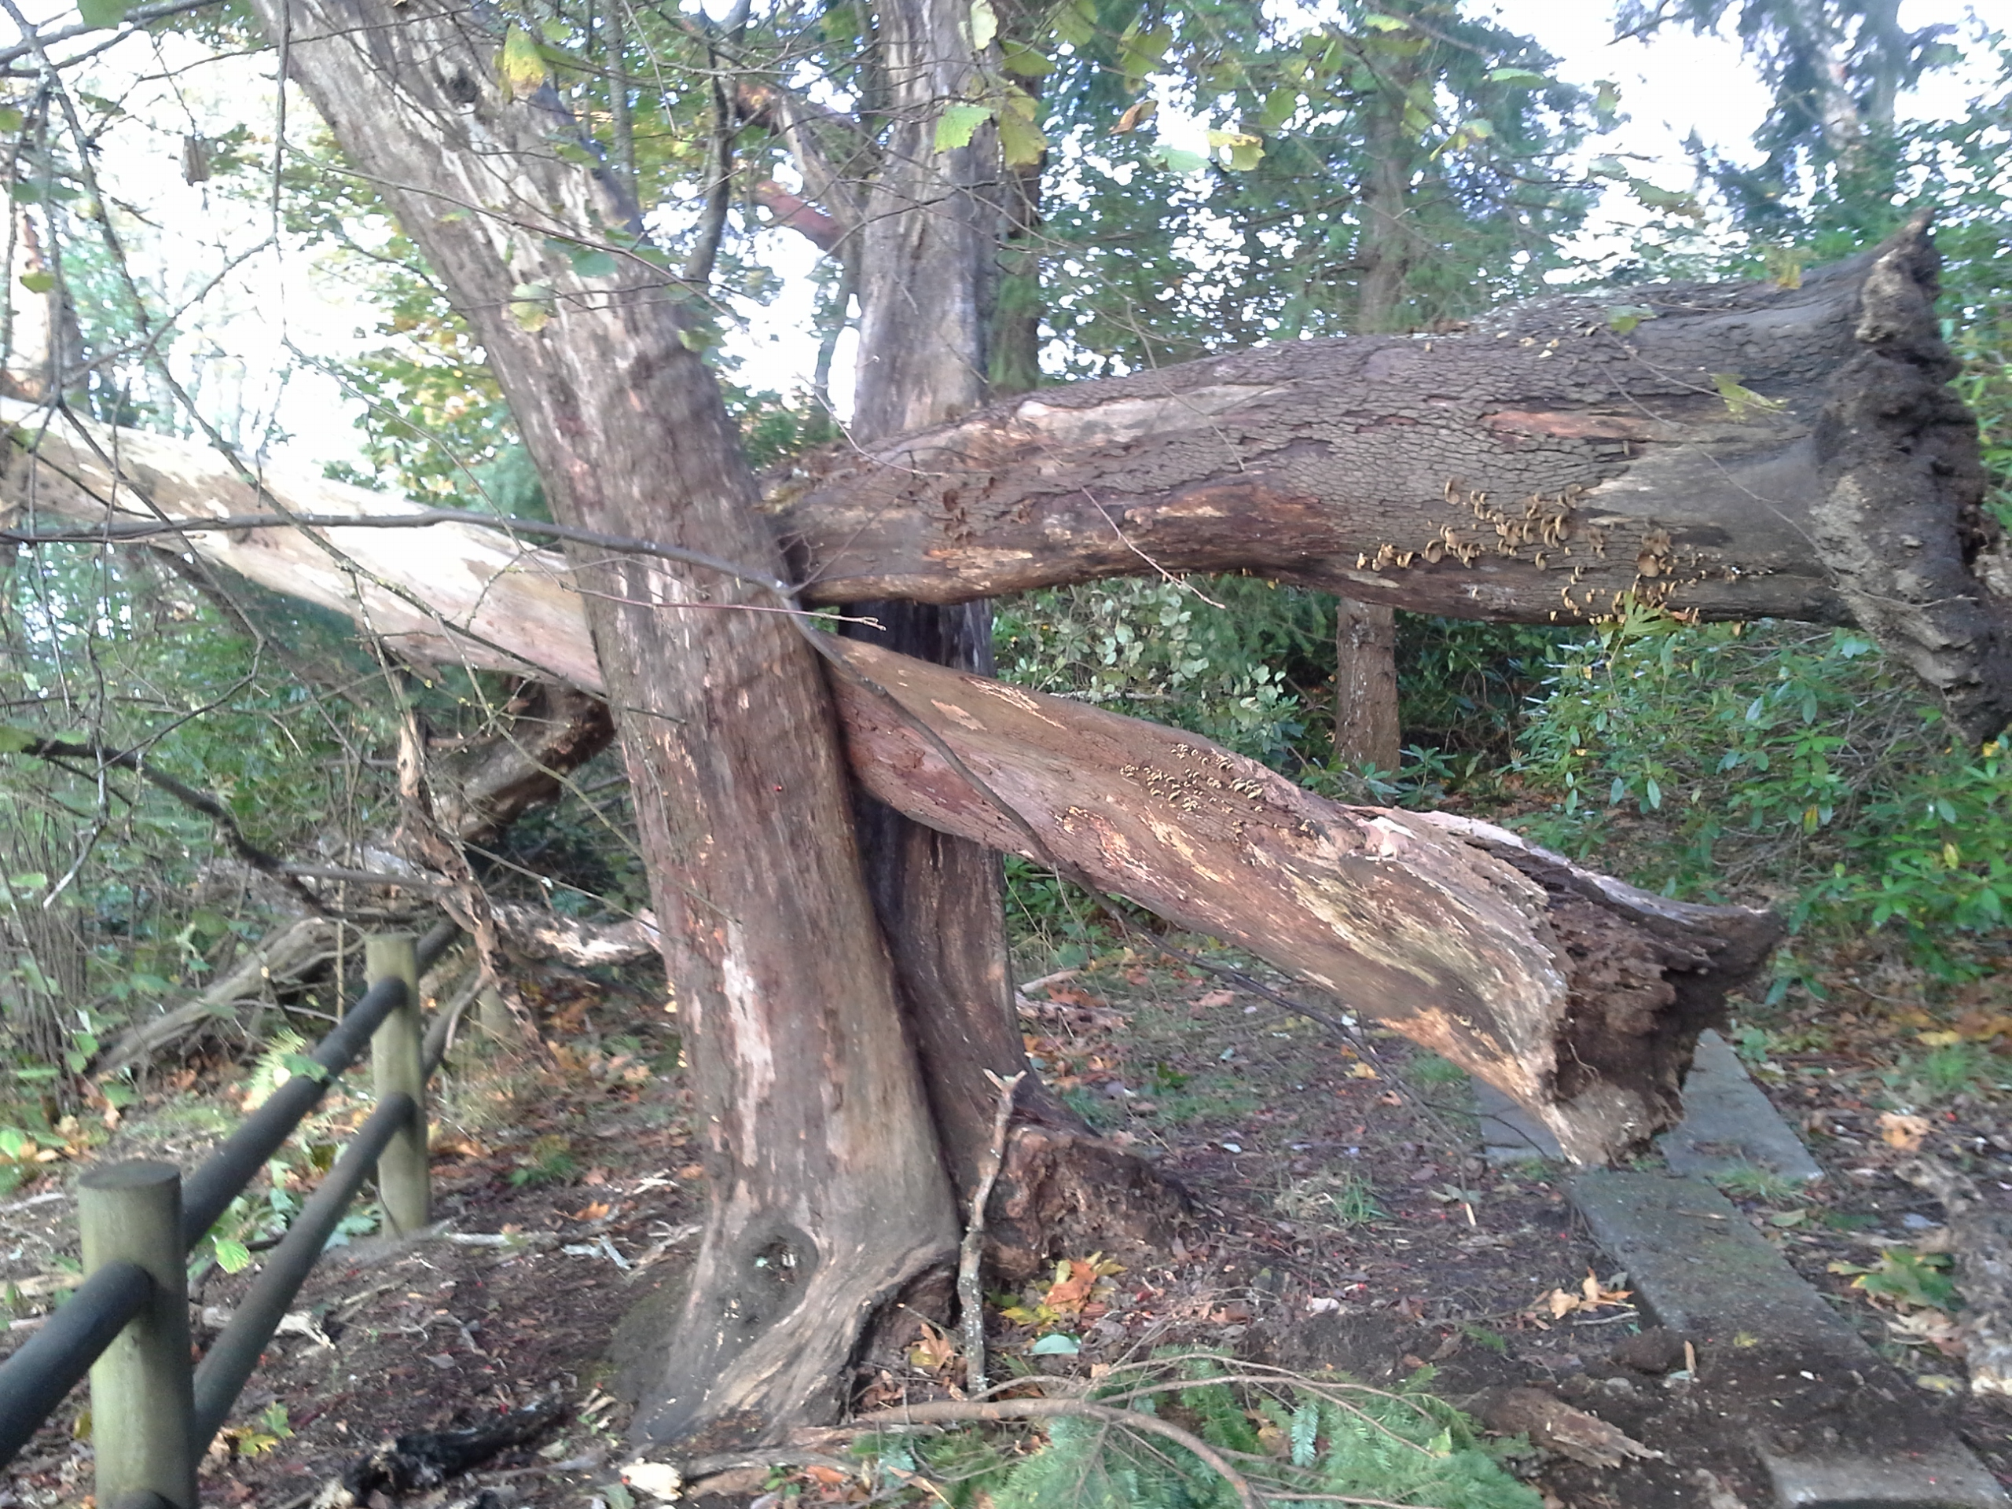
Notes:
Mark Ahlness
https://www.flickr.com/photos/ahlness/

Slide 12
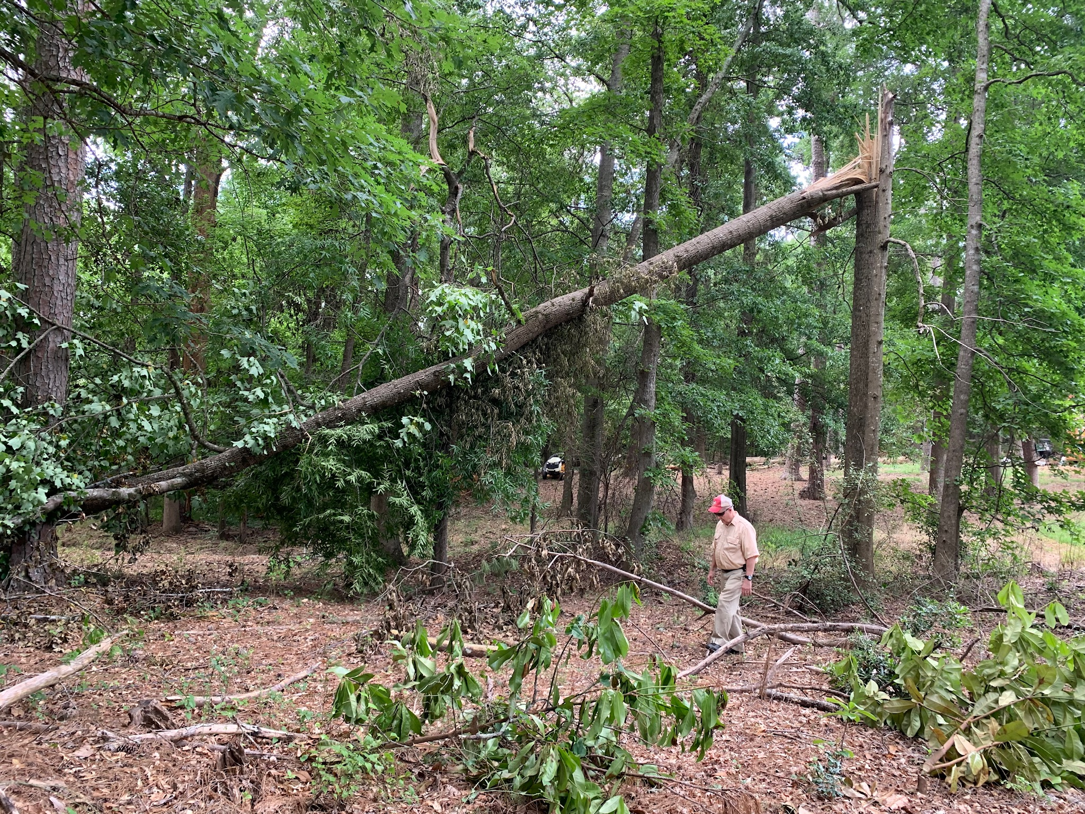
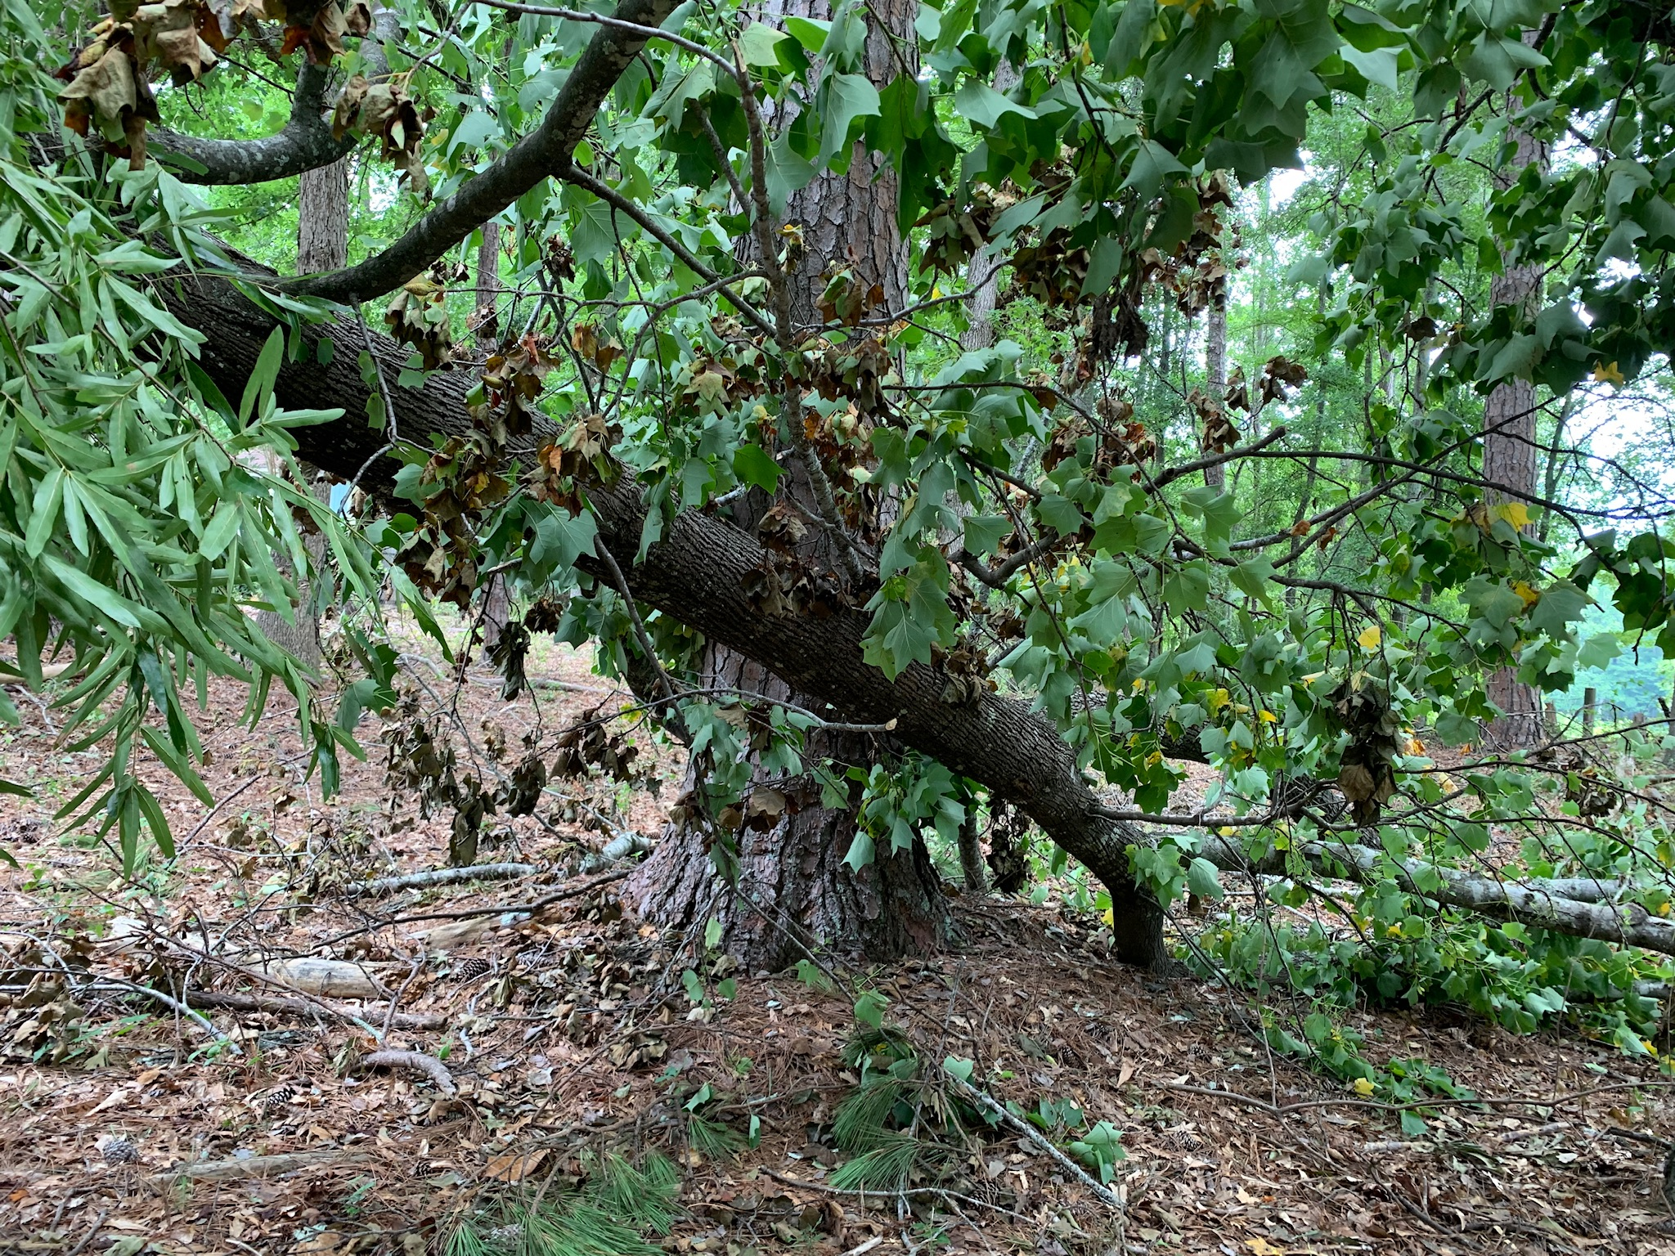
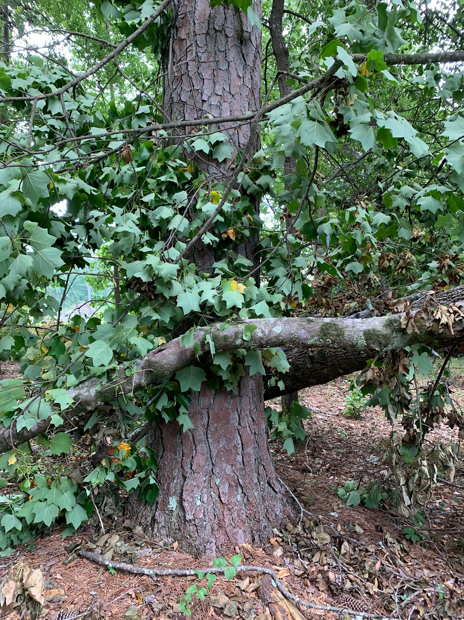
Notes:
Ellen Bauske

