Slide 1


Chainsaw Safety and Tree Cleanup
E.M Bauske, W. Williams, H. Kolich,
J. Fuder, and A. Martinez-Espinoza
This material was produced under grant number SH-05052-SH8 from the Occupational Safety and Health Administration, U.S. Department of Labor. It does not necessarily reflect the views or policies of the U.S. Department of Labor, nor does mention of trade names, commercial products, or organizations imply endorsement by the U.S. Government.
Notes:
Tree Cleanup and Chainsaw Safety
E.M Bauske, W. Williams, H. Kolich, J. Fuder, and A. Martinez-Espinoza
#1 Read the disclaimer.
There are two books that will help you operate the saw safely: the operator’s manual for your saw and the American National Standard for Arboricultural Operations, also known as ANSI Z133. OSHA follows this ANSI standard. ANSI stands for the American National Standards Institute.

Slide 2

Sister Margaret Ann
Notes:
#2 Sister Margaret Ann Video
https://youtu.be/e-ozLCZT4wg
When disasters happen, it’s natural to want to help out. Let’s watch as Sister Margaret Ann jumps right in to help clean up after a storm.
Show the video.
Show the video.
We can probably agree with Sister Margaret Ann, that lending a hand is a good habit. But one of the first rules of emergency response is to make sure you don’t become another victim in need of help.
What risks do you noticed in the video? (No PPE for chainsaw user; bad positioning -cutting below knees without kneeling; clothing that can get caught in the saw; in the road with no traffic control or barriers, Poison ivy, insects, abrasions . . .) What is her plan? She appears to be making random cuts with no plan.

Slide 3
Tree Care Industry Association
(statistics change, trends don’t)
Type | 2016 | 2017
Falls | 48 | 42
Struck-by | 38 | 43
Electrical Contact | 34 | 22
Total (All types) | 153 | 129
Notes:
#3 TCI Stats
The Tree Care Industry Association reported 153 Occupational Accidents in 2016 and 129 in 2017. Chainsaw cuts fall under Struck-by.
The youngest victim TCIA recorded was 18, the oldest was 70. The median age of the victim (all incidents) was 39 in 2016 and 43 in 2017. This relatively high median age suggests that complacency rather than ignorance plays a significant role in these incidents.
In support of this claim:
The typical fall victim was unsecured.
The typical struck-by victim failed to clear the drop zone.
The typical electrocution victim violated MAD (Minimum Approach Distance) and made contact through a conductive tool/object.

Slide 4
The Basics of Safety
Personal Protective Equipment
Chainsaw Safety Inspection
Safe Carry
Safe Start
Notes:
#4 Safety Basics
Read slide

Slide 5
Personal Protective Equipment – PPE
Why people resist wearing it:
Uncomfortable
Not necessary for the task
Not near work site
Too hot
Unattractive looking
OSHA 2006
Notes:
#5 PPE Complaints
Many people don’t like PPE.
Read slide and respond to each point with these points.
If it is uncomfortable, get PPE that is comfortable. Get the appropriate size, better fit or flexibility, or a different design to work better with other PPE components.
PPE is necessary. The chain moves at 68 miles per hour or 88 feet per second. At full speed, 600 teeth pass a given point per second.
Yes, it can be hot. It is always hot in the summer, period. Stay hydrated and take cooling off breaks.
You look foolish without it. Be safe, look professional, and set a good example with it. Wear PPE.

Slide 6
OSHA Required PPE
Hard Hat (ANSI Z89.1)
Safety Glasses (ANSI Z87.1)
Ear plugs or Muffs
Chainsaw Chaps/Pants
Appropriate Foot Wear
Recommended: Glove and Chainsaw Protective Boots
Notes:
#6 Required PPE
This is the required PPE for chainsaw use. If you are an employee, your employer shall provide you with this. “Shall” is the word used in ANSI Z133. When ANSI Z133 says “shall,” it means “MUST.”

Slide 7


Hard Hat /Helmet
When should you wear it?
How do you know if it is safe?
Can I wear a cap, scarf or liner in cold weather under the helmet?
Can you put decals or spray paint the hard hat?
How long can you use a hard hat?
If a big branch falls on me, I’m going to die anyway, why bother with a hard hat?
ANSI Z89.1
Notes:
#7 Hard Hat Questions
When should a hard hat be worn? Any time there is risk for head injury. Generally speaking, any time you are near a work site.
It is safe if it says Z89.1 on it.
Manufacturers specification will say what can worn under the hat. They sometimes recommend specific liners.
Yes, decals can be use, but avoid applying paint to the hard hat. It can damage the plastic.
How long can they be used? Replace hard hats after 3-5 years, sunlight makes the plastic brittle over time. Check the harness and the squeeze the helmet to look for cracks before use.
Hand out the hard hats. Ask them to find the Z89.1 and if they would use that hard hat.

Slide 8

This is why you need a hard hat!
Notes:
#8 Benefits of a Hard Hat
https://youtu.be/m_V8GsPdGyc
A small object gathers great force when falling. A hard hat can make the difference between a headache and death.
This video will demonstrate.

Slide 9
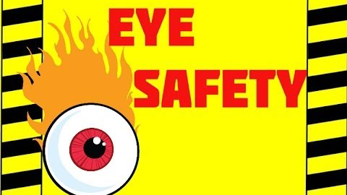
Eye Protection
Notes:
#9 Eye Protection Video
https://youtu.be/pfAZwGZS-Hk
We are going to watch a little of this excellent video. It makes a good point about the implications of eye injuries. Stop Video around time stamp 1:05.
Some people say that the wood chips from a tree won’t hurt you. But the truth of the matter is that you never know what might be in the tree you’re cutting.

Slide 10
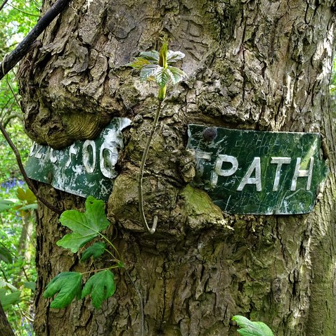
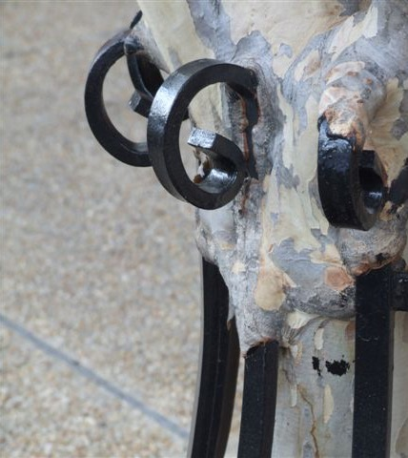
You never know what is inside a tree!
Notes:
#10 Trees Grow Around Irritations
Many strange that have been found in trees. People put wires, bullets, conduit, hook and eye latches, barbed wire, pipe flanges, tennis balls, fabric, plastic bags, concrete, expanding foam, pipes, and rocks in them.
Trees do not expel foreign objects; they grow around them. They can grow around all sorts of irritations.
This footpath sign is about to disappear. This tree is swallowing a fence wire. This decorative fence will be inside this crepe myrtle tree in no time. People hide things in tree crotches and forget about them. Years later, a chainsaw or mill saw that finds these treasures may create flying shrapnel that can cause injury.
Photo Credits
BarkandWire by David R. Tribble
Curious Footpath sign embedded in a tree Photo © Neil Theasby (cc-by-sa/2.0)

Slide 11
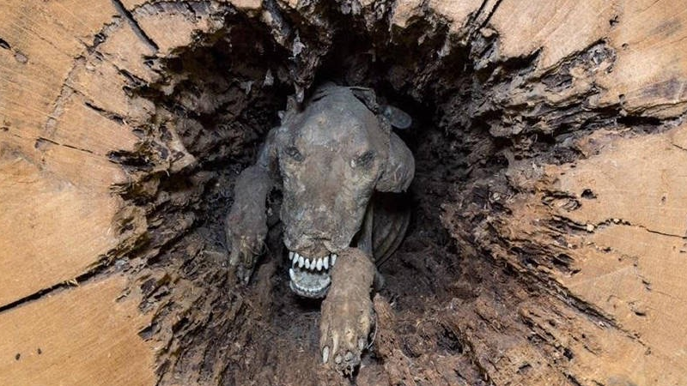
Meet Stuckie
https://allthatsinteresting.com/stuckie-mummy-dog
Notes:
#11 Stuckie
Creatures like trees too, operators come across racoons, squirrels, and even a snake or two. However, some finds are just incredible.
Loggers cut off the top of a chestnut oak tree and they found a brown and white hunting dog!
About 60 years prior to harvest, the dog ran into a hole at the bottom of a tree and shimmied 28 feet up, probably chasing something. The poor dog was named Stuckie by the people who found him
How was Stuckie so well preserved? Chestnut oaks contain tannin, which is used to tan animal pelts and prevent decay. Tannin is a natural “desiccant,” or material that absorbs moisture and dries out its surroundings.
The low-moisture environment stopped the microbial activity and immortalized poor Stuckie. You can go see “Stuckie” at the Southern Forest World Museum in Waycross, Georgia.

Slide 12
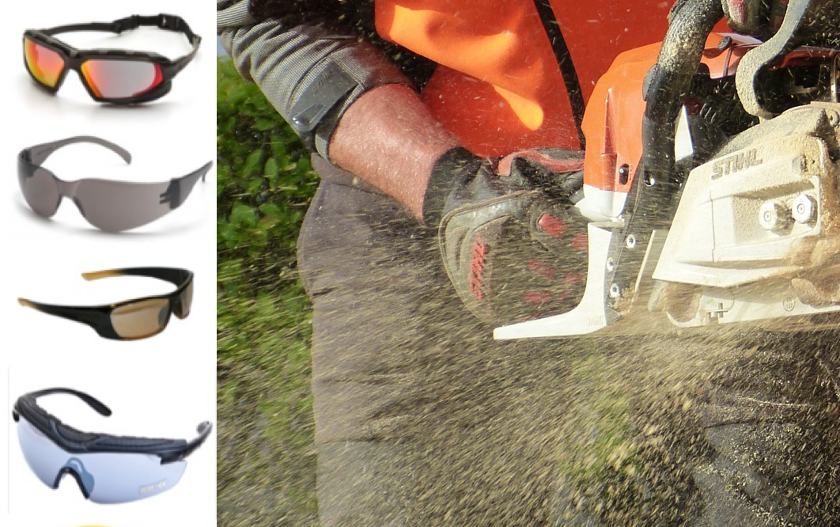
Eye Protection (ANSI Z87.1)
What happened when the tree feller didn’t wear his safety goggles?
He turned a blind eye to saw safety.
Notes:
#12 Safety Glasses
As the chainsaw blade bites into the tree, bark, wood chips, and tiny bits of the metal blade explode into the air. The face and eyes are nice, soft targets for all this flying debris. While a faceguard with a mesh screen protects the face, it isn’t enough to protect eyes from injury. Neither are eyeglasses or sunglasses. Flying objects can shatter the lenses of regular eyewear, increasing the chances of eye injury.
Safety glasses or goggles with side protection or wrap-around lenses, deflect threats that come at the eyes from both the front and the side. There are safety glasses and goggles that fit over prescription eyewear. Alternatively, safety eye wear can be made to a vision prescription, even for bifocals.
Whether prescription or off-the-shelf safety glasses are worn, select models that:
resist fogging up
resist scratches
offer UV protection to minimize eye damage from UV light, and
have an ANSI/ISEA impact rating of Z87.1.
Hand out safety glasses and ask them what the ANSI rating is. There should be at least one set of eyeglasses that is not stamped with the proper ANSI rating.

Slide 13
Lack of hearing protection leads to:
Hearing impairment with poor quality of life
Problems in speech recognition
Difficulties on the job
Notes:
#13 Hearing is Important
Hearing is very important.
Read the slide.
These problems aren’t apparent in young people in their 20s, but become apparent as they age. How many of you have experienced some hearing loss? What are the signs that hearing is damaged?
(Wait for the audience to respond. Possible answers: ringing in the ears, temporary deafness, get in the car the next day and the radio is too loud).
How loud does something need to be to cause noise induced hearing loss?

Slide 14
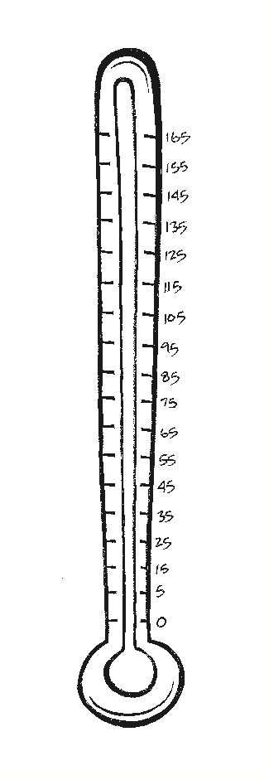
Painful:
150 dB = Rock Concerts at Peak
140 dB = Firearms, Air-Raid Siren, Jet Engine
130 dB = Jackhammer
120 dB = Jet Plane Take-off, Amplified Music at 4-6 ft., Car Stereo,
Band Practice
110 dB = Machinery, Model Airplanes
100 dB = Snowmobile, Chain saw, Pneumatic Drill
90 dB = Lawnmower, Shop Tools, Truck Traffic, Subway
80 dB = Alarm Clock, Busy Street
70 dB = Vacuum Cleaner
60 dB = Conversation, Dishwasher
50 dB = Moderate Rainfall
40 dB = Quiet room
30 dB = Whisper, Quiet Library
Notes:
#14 Noise Measurement
Loudness is only one factor contributing to noise induced hearing loss. Length of exposure and proximity to the noise are also factors. Sound is measured in decibels (dB). When exposed to noise at the 85dB level or above repeatedly or for long periods of time, hearing loss is likely.
How many decibels of noise does a chainsaw produce? A new saw runs at about 100 dB and old one can be louder.
ANSI Regulations are clear, “The employer shall (this means MUST) provide employees protection against the effects of noise exposure when sound levels exceed an 8-hour, time-weighted average of 85 decibels.”

Slide 15
Noise Reduction Rating
NRR
Notes:
#15 NRR
Look for the NRR (Noise Reduction Rating) on ear protecting equipment. The NRR is a single number rating which is required by law on the label of each hearing protector sold. It states the noise reduction the device provides.
An NRR of 25 reduces noise levels by 25 dB. An NRR of 33 reduces noise levels by 33 dB.

Slide 16


Notes:
#16 Where is the NRR?
Use this slide to show them where the NRR is.
Pass out the hearing protection and ask participants to find the NRR. There should be one device that is not labeled. You should tell them not to use that one.

Slide 17
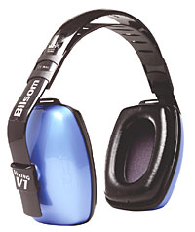
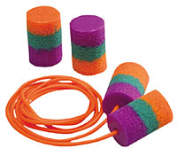
Danger!
+
=
Notes:
#17 Don’t Overprotect
It is important not to block out all the sound. There are some sounds that must be heard.
Ask the group what they need to hear? (e.g. tree cracking, co-workers, road traffic.)

Slide 18
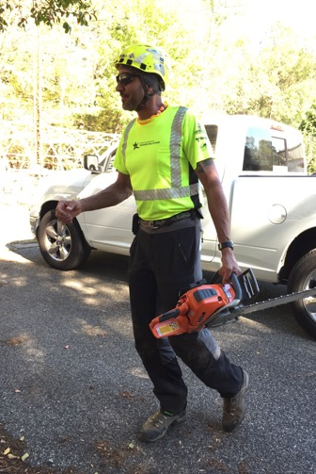
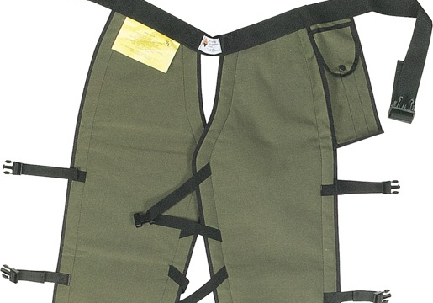
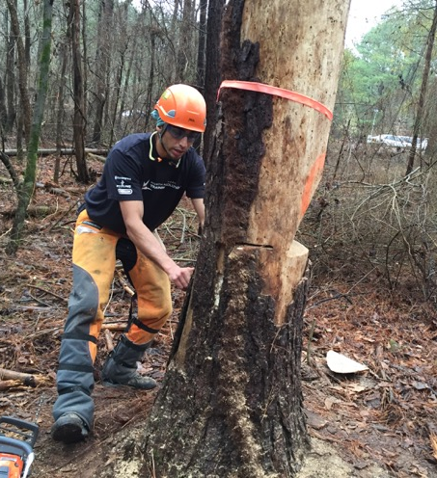
Chaps or Saw Pants
Notes:
# 18 Chaps
Moving on down, let’s look at protection for the body.
The CDC reports, “Each year, approximately 36,000 people are treated in hospital emergency departments for injuries from using chainsaws.” Saw cuts are ugly cuts. The most common place for cuts is on the left hand. Do you know why? (One handing the saw and feed brush into it with the left hand). Good technique will protect from that accident. The second most common area for a saw cut is the left leg. Why? (You get tired and the saw tends to rest there.)
There is only one article of PPE that protects from cuts. That is the chaps or chainsaw pants.
Fasten all the buckles on chaps and keep them snug. They should cover the full length of the thigh to two inches below the top of the boot.
Have someone demonstrate putting on chaps.
If a saw is used daily, it is wise to invest in safety pants. They look good, fit well, and they are always on. They cost a bit more, but the added comfort makes them worth it.
Pass around the pants.

Slide 19
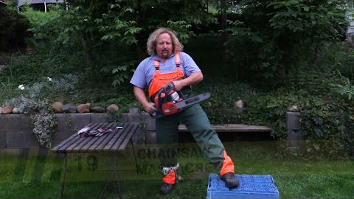
Don’t Try This At Home!
Notes:
#19. Don’t try this at home!
Pavel is going to show us why safety chaps and pants are a good investment.
https://youtu.be/r5VSivQe760
Read and understand the manufacturer’s care and use instructions. Chaps and pants must be washed. They aren’t effective dirty. Some are machine washable in cold water, but they don’t like the dryer or chlorine bleach. Read the care guidelines and follow them.
If saw chaps/pants are cut, they must replace them. One cut, you chuck!
Pass out the cut chaps so they can see the fibers.
Always keep chaps/pants on when using a saw. They are worthless in the truck.

Slide 20

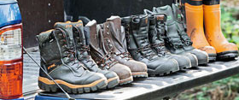
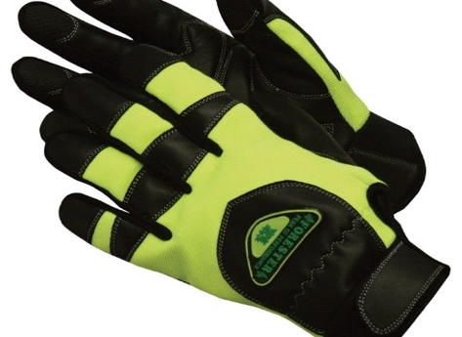
Gloves and Boots
Notes:
#20 Gloves and Boots
What are some characteristics of a good pair of gloves?
Gel padding in the palms to reduce vibration.
Lined with cut-resistant DuPont Kevlar fiber to prevent minor cuts. They should be rated at Level 3 for cut resistance. (ANSI/ISEA 105-2005 Standard).
Snug fit. Get the right size to fit your hands.
Non-slip with breathable Spandex with goatskin or other materials that provide good control for your fingers and palms. Make sure the top of the glove is well made.
Wrist closure with Velcro keeps debris out and doesn’t get caught in things like chippers, saw tips, or sticks (no cuffs).
Machine washable if possible.
What are characteristics of a good boot?
Correctly fitted to the size of your foot.
Lined with DuPont Kevlar for chain cut resistance.
High abrasion resistance.
Steel shank for support.
Moisture repellent upper.
Pillow cushion inserts.
Steel, titanium or plastic toed boots. Titanium and plastic toed boots reduce the overall weight of the boot.

Slide 21
If near traffic or hunters
Notes:
#21 Vests
A high visibility safety vest is necessary near traffic and wise when out in the woods.
Show them the demonstration vests and note the pull apart vest could be good when working around chippers.

Slide 22
Watch Out For Bites and Stings
Chiggers
Ticks
Mosquitoes
Fire Ants
Notes:
#22 Insect Pests
These pests are always out there, but they may be in places you don’t expect to see them after flooding.

Slide 23

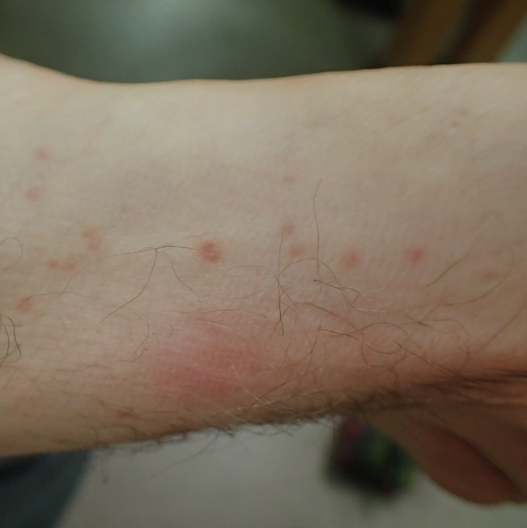
Chiggers
Notes:
#23 Chiggers
Chiggers (red bugs) are baby mites. They normally feed on snakes and lizards; they cannot survive on humans. Unfortunately, their salivary secretions cause severe reactions by the human immune system, leaving us itching for a week afterward. (Meanwhile, the chigger has died within hours of attaching to us.) Contrary to folklore, chiggers do not burrow into human skin. By the time itching starts, the larval mite has died and fallen off, so treatment from this point on is treating the symptoms. (Once the chigger has injected its salivary secretions, it is all over but the scratching.)

Slide 24
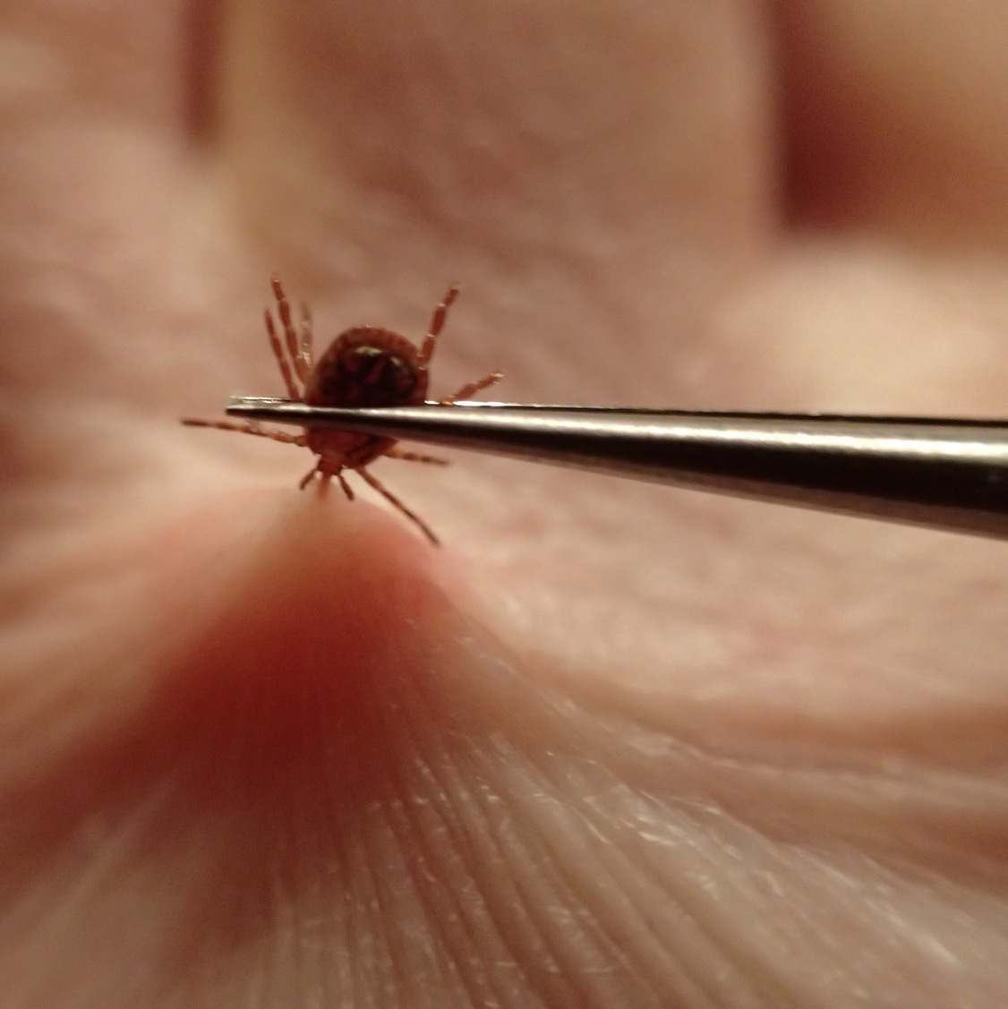
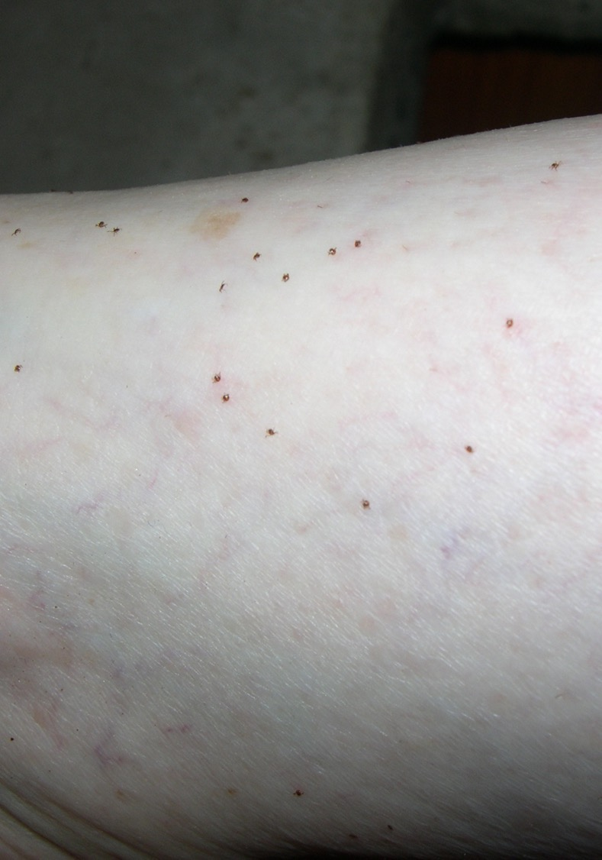
Ticks
Notes:
#24 Ticks
Adult Tick (Left) and Seed ticks (right).
Remove ticks by grasping them with tweezers and pulling straight out. No need for any of those other tick removal gimmicks. Use tweezers to help insure removal.
Be aware of the symptoms of tick-borne illness. The Center for Disease Control and Prevention (CDC) reported an increase in the number of annual reports of tick-borne bacterial and protozoan diseases. There were less than 22,000 in 2004. In 2016 there were over 48,000. Lyme disease accounted for 82% of all tick-borne disease reported. Scarier yet, the CDC suspects that the number of cases was substantially underreported.
The CDC says the most common symptoms of tick-related illnesses are:
Fever/chills
Aches and pains
Rash
Other symptoms
Go see you’re your doctor promptly if you experience these symptoms.

Slide 25
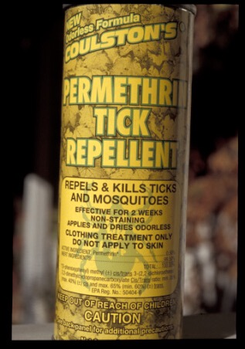
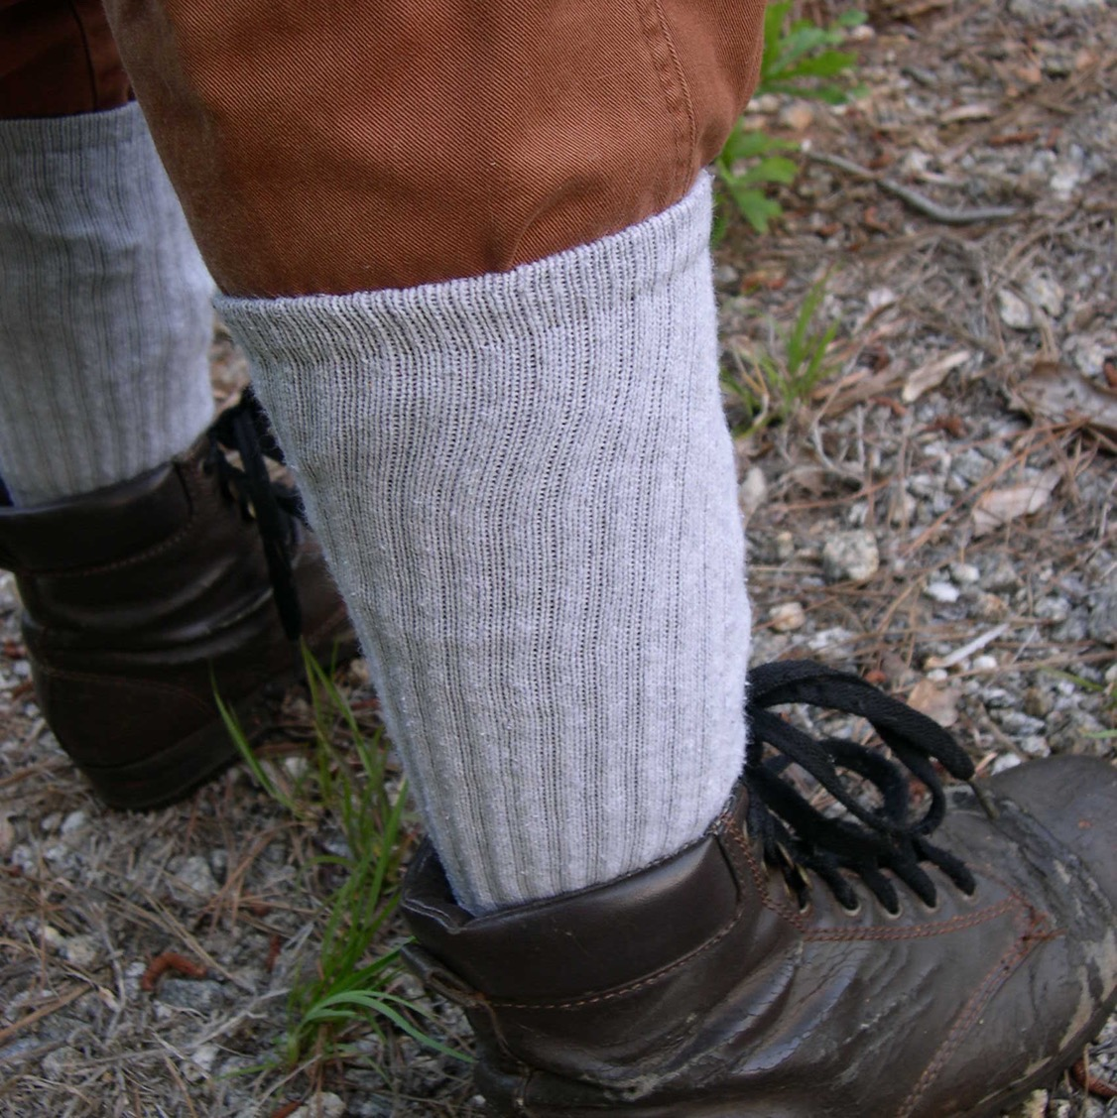
Notes:
#25 Permethrin
Products containing Permethrin (often sold under the trade name Permanone® ) can help keep chiggers and ticks off you. Spray your pants legs and socks with products containing permethrin.

Slide 26
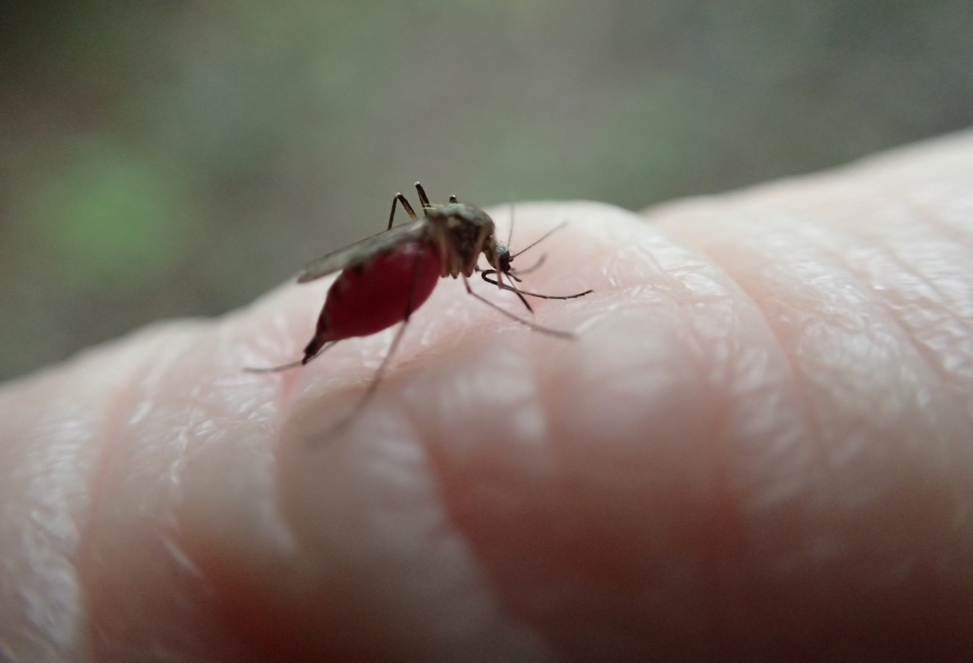
Notes:
#26 Mosquitoes
Female mosquitoes feed on blood and can transmit diseases. . There may be more mosquitoes after heavy rains and flooding because there is more standing water in which they can breed. DEET containing products are effective repellants.
Permethrin works too.
DEET can go your skin, Permethrin goes on your clothes.

Slide 27
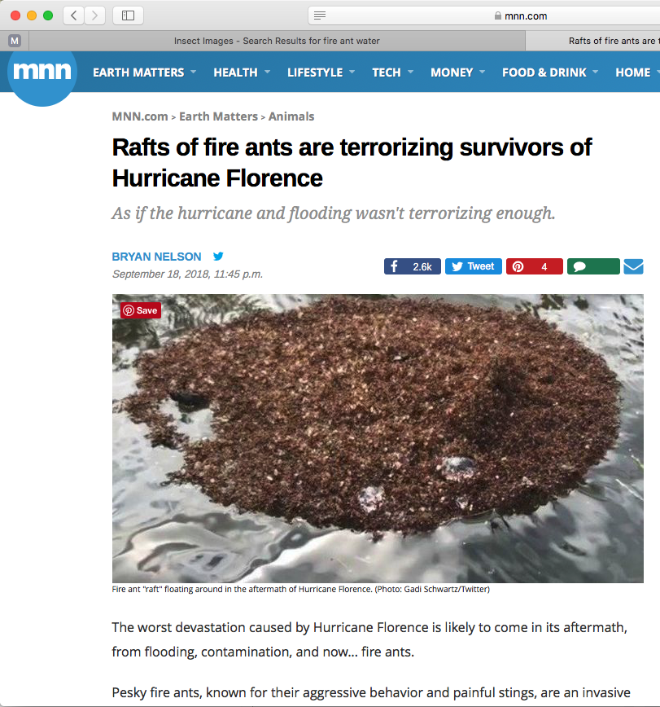
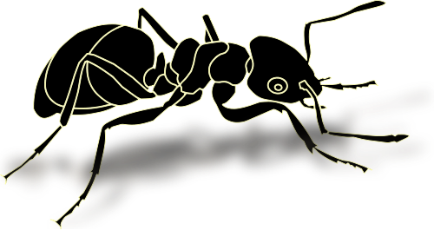

Notes:
#27 Fire Ants
Fire ants, known for their aggressive behavior and painful stings, are an invasive species. They are known for being rugged survivors. In fact, they are especially adept at surviving floods They band together to create "rafts" that float until the waters recede and they can rebuild their colony.
The raft exterior is largely composed of workers, who protect the core of the ant colony on the interior: eggs, larvae, and the queen.

Slide 28
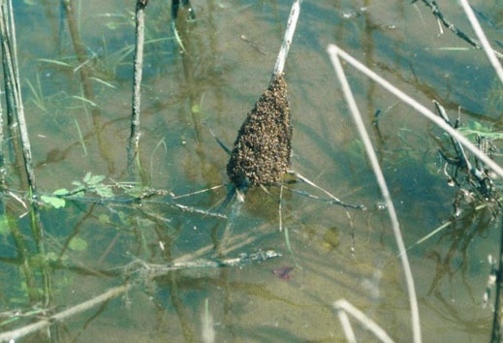
Brian Lockhart, USDA Forest Service, Bugwood.org
Notes:
#28 Rafting
As soon as the raft touches something solid, which might be a boat or a person's skin, the ants will immediately latch on.
If they latch on to you, rub them off immediately. Don’t try to submerge them, they will just cling to the skin.
Ant rafts tend to look like regular debris when they are floating in the water. It isn't until you get right up to one that you can see that the cluster is alive.
Be wary of fire ant colonies after the waters recede, as fire ants tend to build their colony back up wherever their rafts land. There could be new colonies in unsuspected areas, including playgrounds, backyards, or parks.

Slide 29
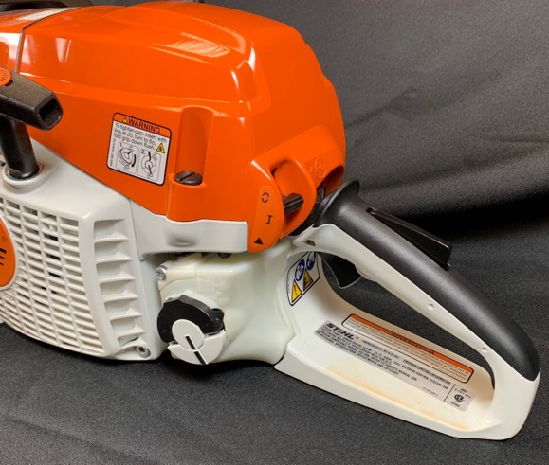
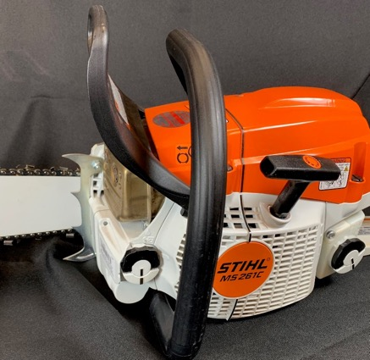
Chainsaw Safety Inspection: Five Essential Safety Features
Chain Brake
Throttle Lock
Right Hand Guard
Notes:
#29 Five Essential Safety Features
Before using a saw, look for these five essential safety features.
THROTTLE LOCK: The throttle lock is designed to prevent accidental throttle advance. The throttle will only work if the lock is pressed in, i.e. the saw’s rear handle is held with a firm grip while accelerating.
RIGHT-HAND GUARD: The right-hand guard is designed to protect the user’s hand if the chain should break or derail.
CHAIN BRAKE: The chain brake stops the rotation of the chain. The chain brake is designed to be activated in two ways:
If the left wrist forces the kickback guard forward, the chain brake will activate.
Following kickback the chain brake will trigger from the inertial forces generated.
Anytime more than two steps are taken during cutting, push the chain brake forward with the back of the hand to engage the chain brake. Engage the break when the saw is set down. Never use the right hand to engage the chain break.
.

Slide 30
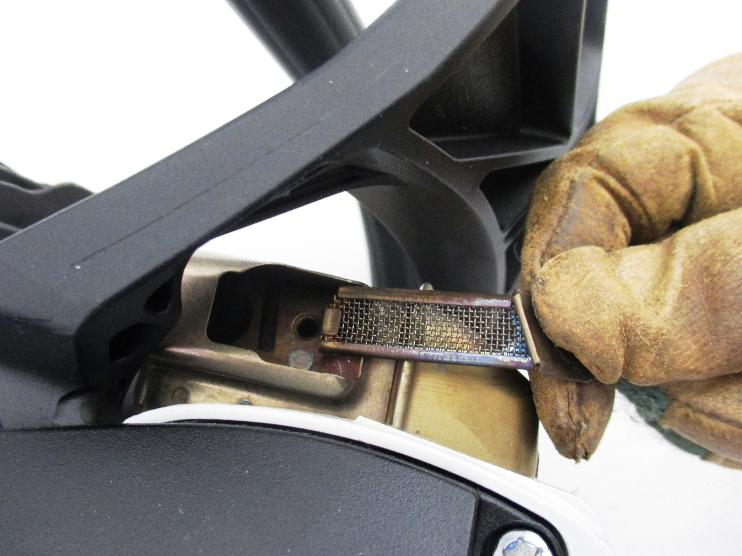

Chainsaw Safety Inspection: Five Essential Safety Features
Spark Arrestor
Chain Catcher
Notes:
#30 Saw Safety Features
SPARK ARRESTOR: Every chainsaw has the potential to start a wildfire. Exhaust gases from the combustion chamber of the chainsaw and hot carbon can be ejected through the exhaust port of the engine as sparks.
The muffler is where the buck stops. Chainsaw engineers have added spark arrestors to mufflers to prevent sparks from leaving the muffler. These tiny screens can get clogged up with carbon and must be cleaned occasionally.
CHAIN CATCHER: The chain catcher is designed to catch the chain if the chain should break or derail. It is easy to overlook because it is on the bottom of the saw. They break off but can easily be replaced at the saw shop.

Slide 31
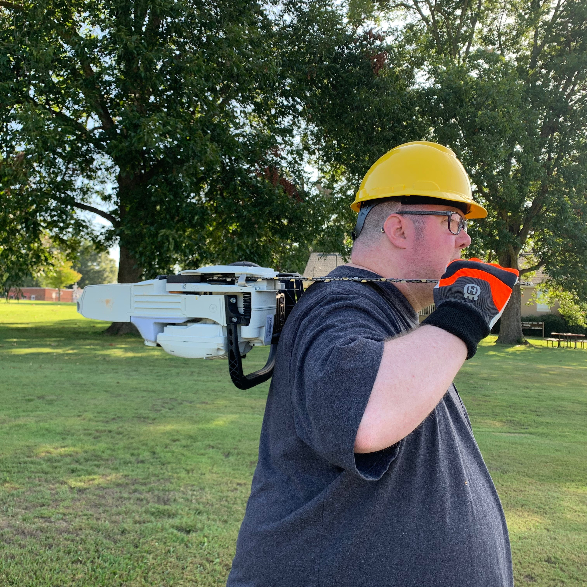
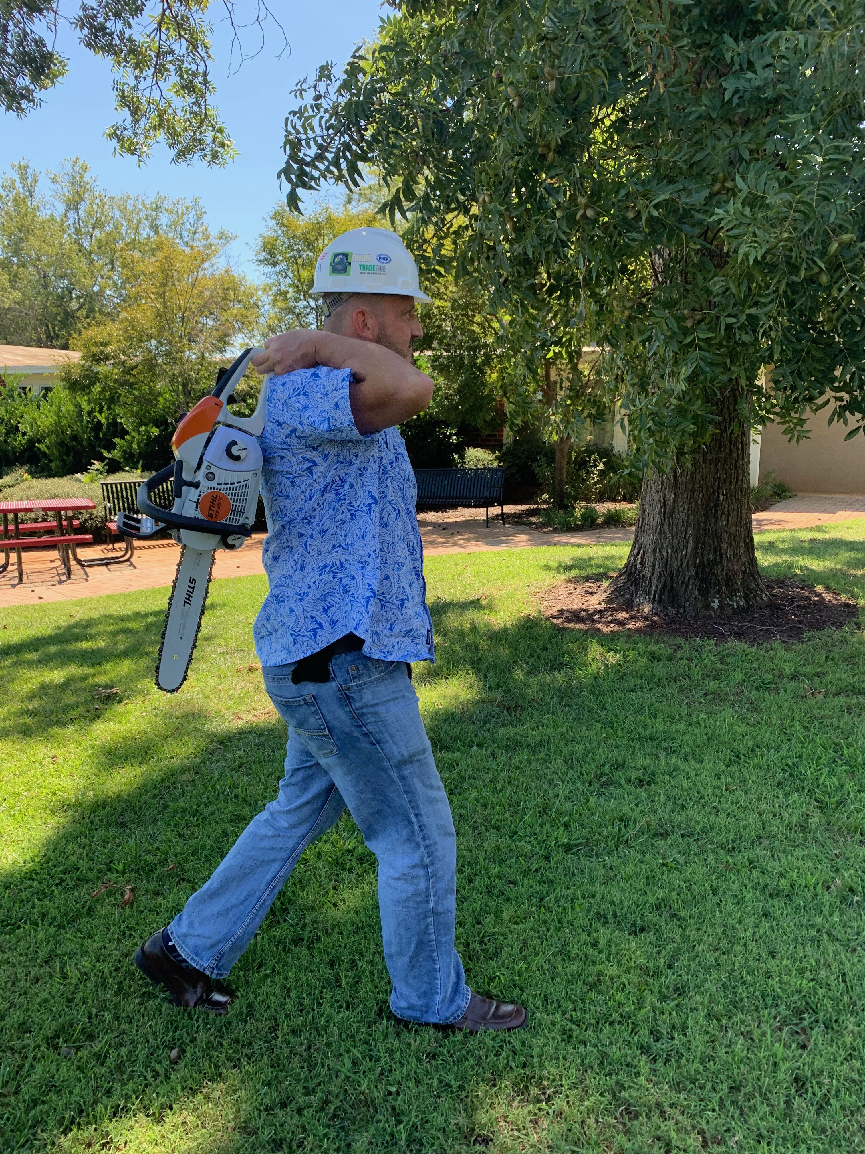
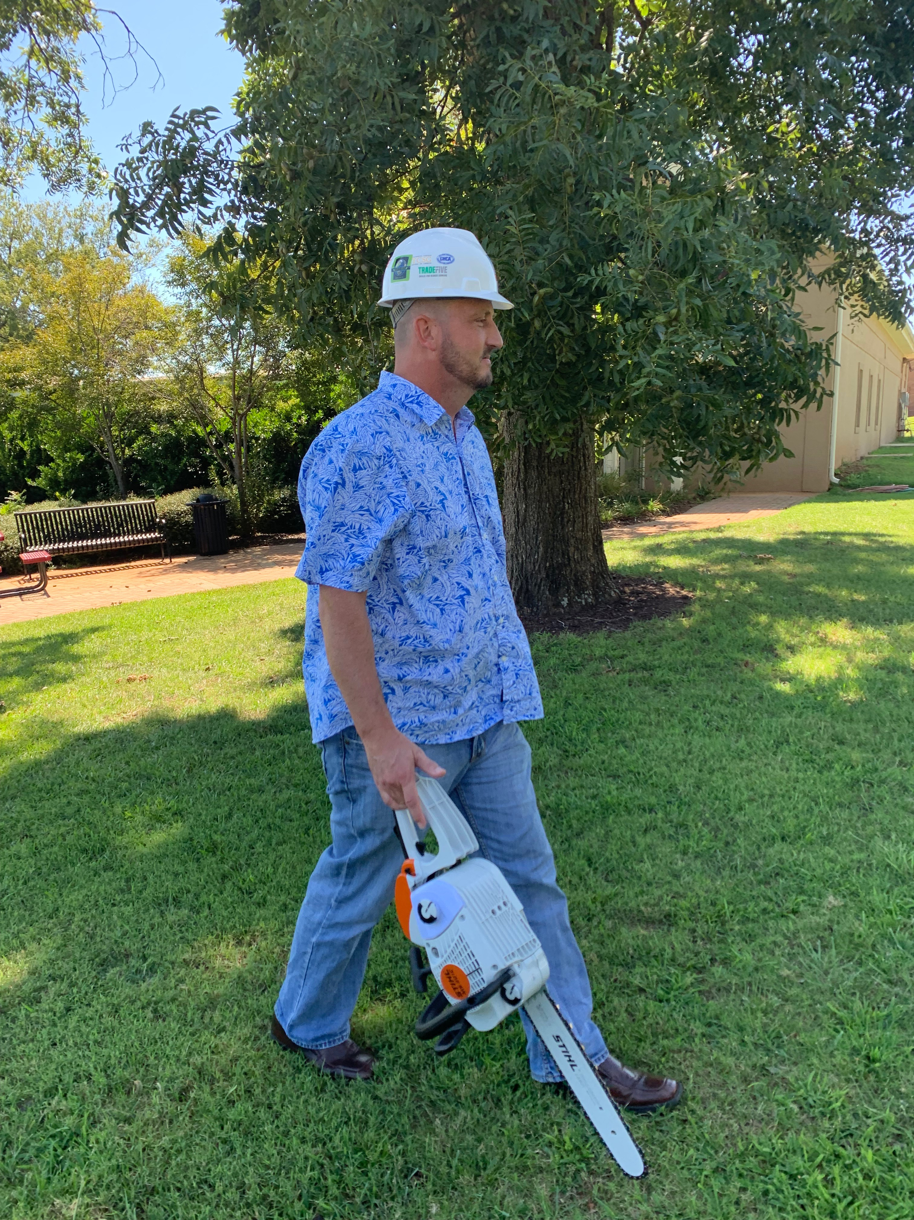
Bad, bad, dangerous, ouch, just imagine if these guys trip!
Notes:
#31 Safe Carry
There are lots of ways to carry a saw, but there is only one safe way.

Slide 32
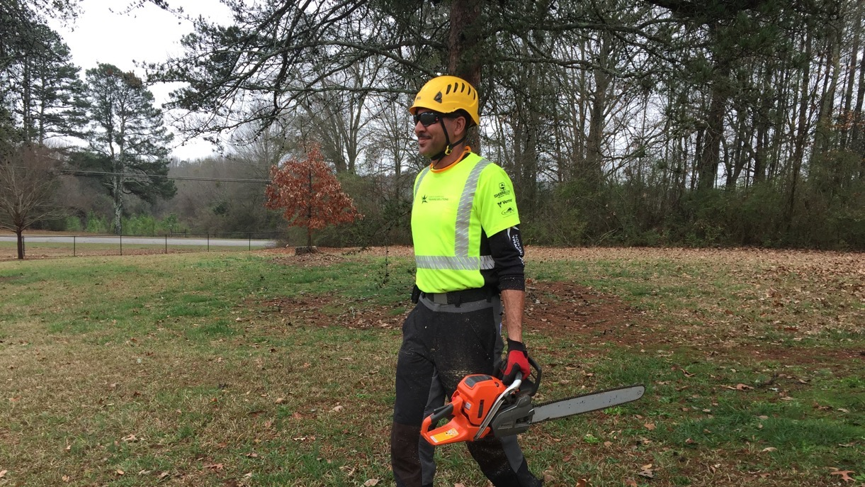
Safe Carry
Notes:
#32 Safe Carry
Always carry the chainsaw with the bar pointed behind you. If the saw has been running it is important to make sure the muffler side is away from the body. Always shut the chainsaw off before transporting.
This is an example of safe carrying technique: Saw powered off, bar behind.

Slide 33
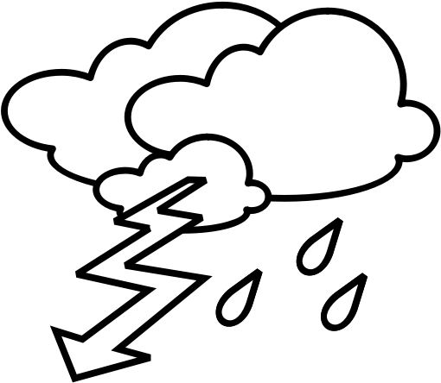
Electricity:
Before You Cut Anything
Make a thorough inspection.
Line clearance shall not be performed during adverse weather conditions, such as thunderstorms, high winds, and snow and ice storm. (ANZI Z133).
Treat all downed lines as energized.
Fences, gutters, anything conductive can be “hot.”
Notes:
#33 Electricity
Tree work hazards increase significantly during or after a storm. Many of the tools relied on to help protect from electrical hazards such as pole pruners, saws, and aerial lifts lose their capacity to insulate when wet. The trees are also much more conductive when they are wet. Strong winds can push treetops into contact with conductors and make controlling cut limbs and tops extremely difficult even with rigging. Tree workers must exercise extreme caution and judgment in these situations and, when warranted, delay the work until the weather improves.
Line clearance is pruning, trimming, repairing, maintaining, removing, or clearing of trees or the cutting of brush that is near (within 10 feet of) energized power lines.
Treat all downed lines as energized.
Since even a streetlamp circuit or phone line can be energized with enough voltage to kill, almost all tree workers in the field have at least some exposure to this hazard. In fact, workers don’t even have to touch a wire to be electrocuted – about half of all electrocution fatalities are the result of indirect contact.
Keep in mind that electricity from a downed line away from you may reach the worksite through other conductors such as chain link fences, metal curbing, or even “harmless” phone or cable lines.
Even the ground under your feet can even conduct electricity, given the right soil conditions and voltage.

Slide 34
Do Not approach or touch any downed lines, (power, communication, cable, or otherwise) until the utility company has cleared it as de-energized or dead.
Notes:
#34 Electricity Warning
Read the slide. Restate the slide.
Keep in mind that electricity from a downed line away from you may reach the worksite through other conductors such as chain link fences, metal curbing, or even “harmless” phone or cable lines.

Slide 35
Generator Feedback
Notes:
#35 Generator Danger
In addition, homeowners using incorrectly set-up generators can cause “back feed” into their house drop, which in turn is “pumped up” in volume by transformers, reenergizing lines the tree crew may have “known” to be dead.
If you hear a generator operating or notice lights on at one residence in an otherwise blacked out area, consider all conductors to be energized.
Once again, do not begin working until the utility company has cleared all downed lines as dead.

Slide 36
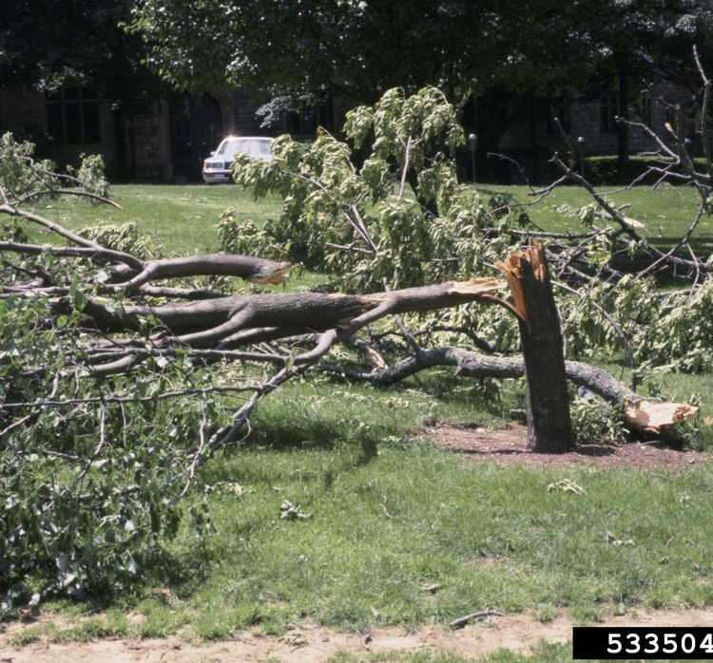
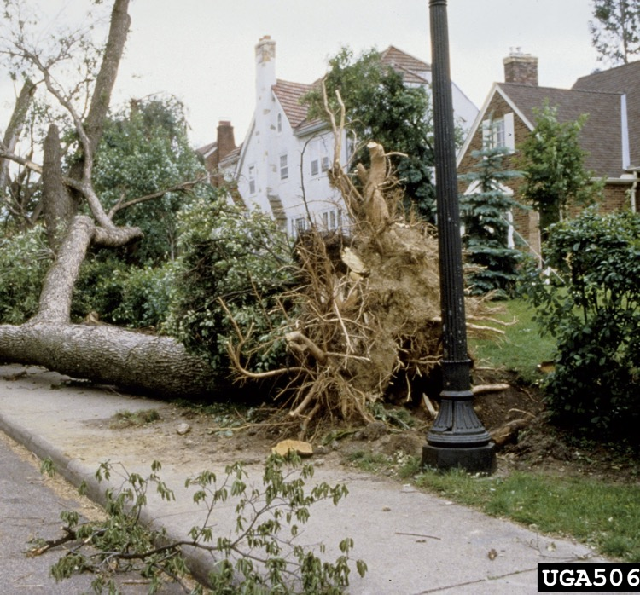
Tripping Hazards
Joseph O’Brien, USDA Forest Service, Bugwood.org
Mary Ann Hansend, VPI & State University, Bugwood.org
Notes:
#36 Remove Tripping Hazards
Clear out small debris before beginning work on a tree. This will help the operator get a better look at the tree and reduce tripping hazards. Continue removing debris throughout the operation. This is the best way to avoid tripping hazards.

Slide 37
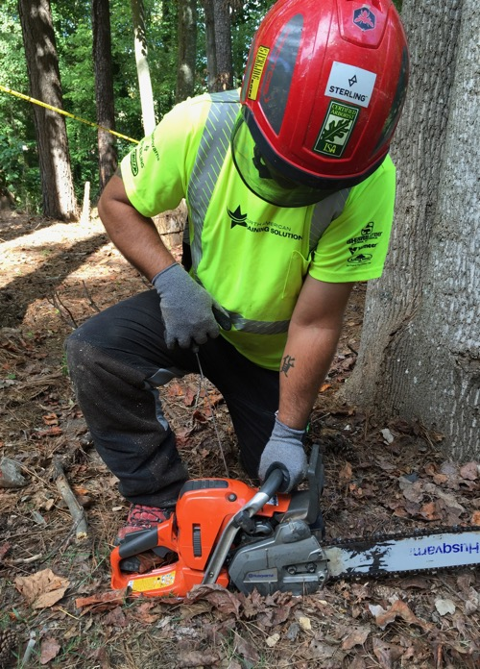
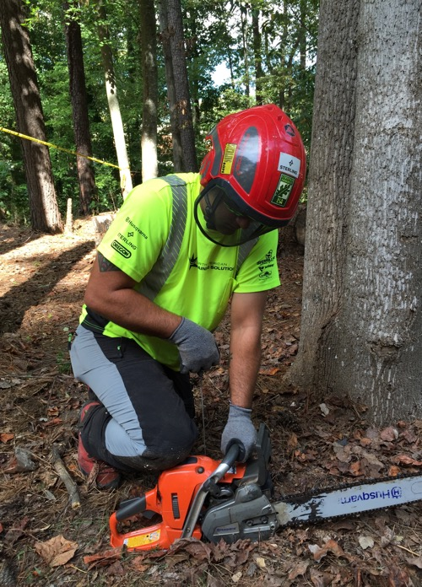
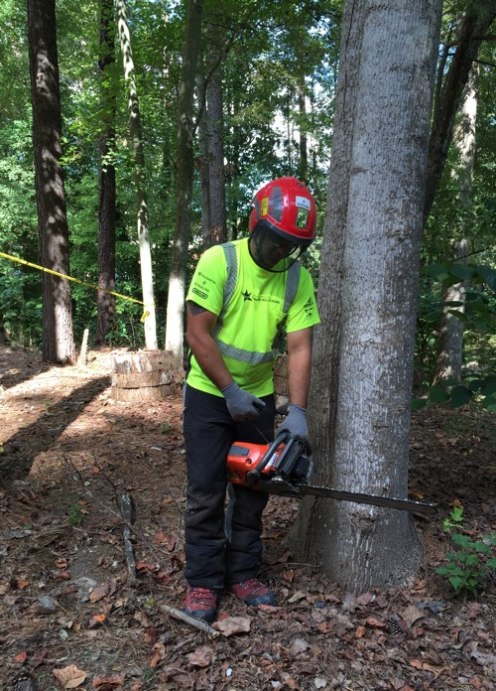
Safe Start
Notes:
#37 Safe Start
Drop-starting a chainsaw is prohibited.
Prior to starting make sure to check controls, chain tension, bolts and handles. Do not start a saw within 10’ of fuel. Engage the chain brake and place the saw on flat ground or another firm surface, place the RIGHT boot toe in the handle or knee on top to stabilize before pulling the cord. The LEFT hand should be firmly around the handle with the elbow locked. When starting on the ground make sure the bar is not in contact with the ground or any objects. If ground starting is not possible due to debris or other obstructions, then a standing or pinch start can be done. Standing on firm ground with rear handle between the legs the LEFT hand around the front handle with the elbow in a locked position.

Slide 38
Final Comments:
It is unwise to cut trees or wood alone. At least let someone know where you will be cutting and an estimated time of return.
Look for and take advantage of training opportunities.
Notes:
#38 Final Comments
Read this slide.

Slide 39

Questions?
Notes:
#39 Any Questions?

